Slide 1
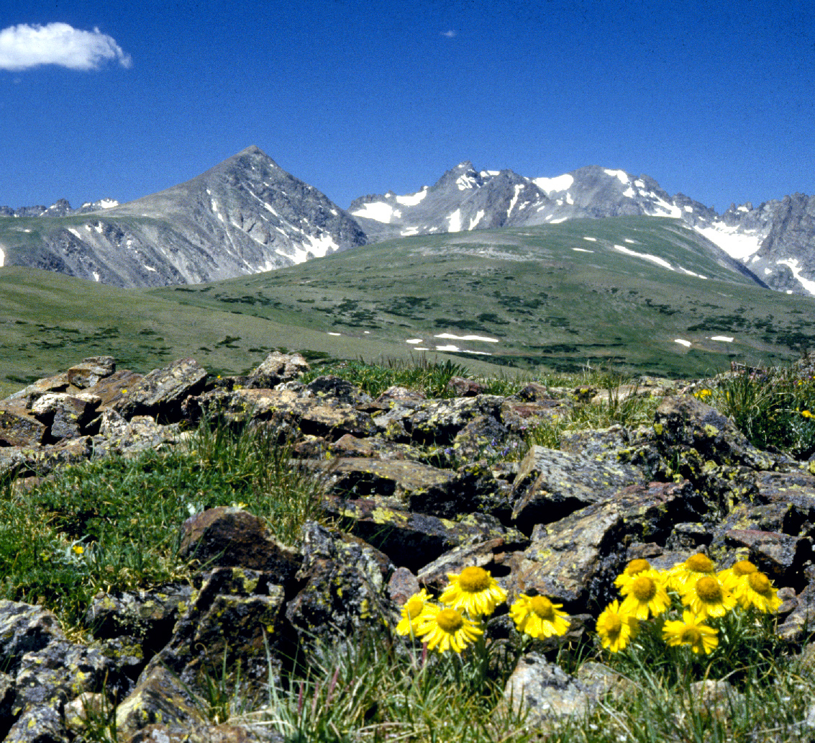
Climate Change in the Alpine
North Central Climate Adaptation Science Center
Rapid Climate Assessment
Aly Ennis, Meagan Oldfather, Imtiaz Rangwala, Kyra Clark-Wolf, and Caitlin Littlefield
Image: B. Bowman
Notes:
Hi everyone! I'll be reporting back about progress on the Rapid Climate Assessment for alpine systems that I’ve been working on with Meagan Oldfather, Imtiaz Rangwala, Kyra Clark-Wolf, and Caitlin Littlefield

Slide 2
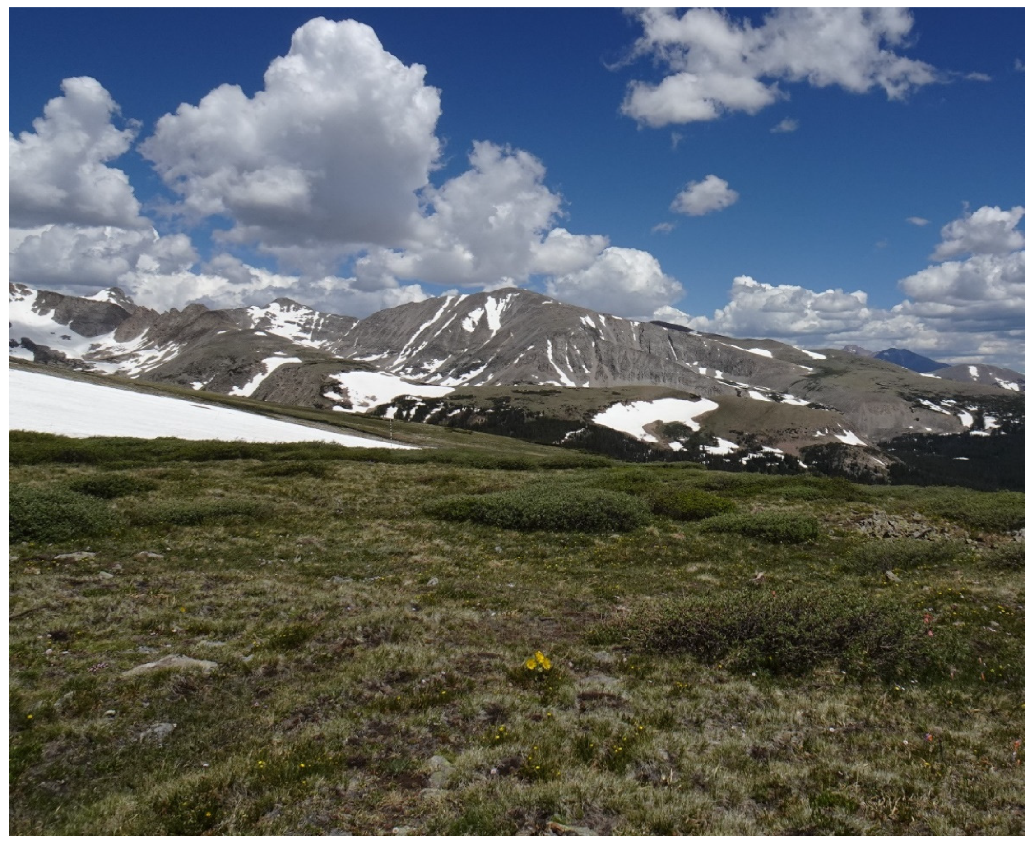
Background
Alpine and treeline systems are very heterogeneous
A reduction of physical area at higher elevations, the sensitivity of alpine species to climate, and low connectivity make them particularly vulnerable to climate change
With climate change, we’re seeing elevation-dependent warming, loss of snowpack, and increased glacial and permafrost melt
Photo: C.M. Tate
Notes:
So first some background
Alpine and treeline systems are very heterogeneous, characterized by complex topography, high spatial and temporal climate variability, and extreme climate events even in “normal” times
Some characteristics of alpine systems that make them particularly vulnerable to climate change are a reduction of physical area at higher elevations (so less area at the tope of a mountain), a general sensitivity of alpine species to climate, and low connectivity between alpine areas
With climate change in the alpine, we’re generally seeing elevation-dependent warming, a loss of snowpack, and increased glacial and permafrost melt.

Slide 3
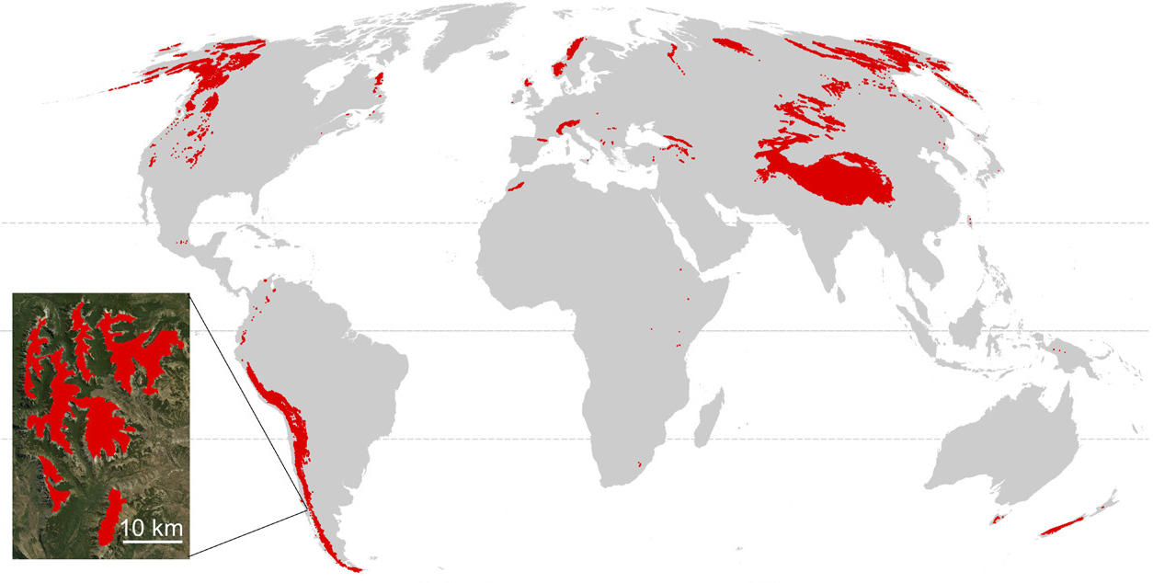
background
Initial responses of species to climate change may be very localized
Life-history of current alpine flora and fauna will likely lead to extinction debt
Regionally, our alpine and treeline systems are xeric, making it more likely to be impacted by warming AND drying
Figure: Testolin et al 2020
Notes:
This is a map of the global distribution of alpine systems, with the inset showing the heterogeneity within a 10 kilometer region of an alpine environment in the Andes.
What we know about how alpine areas may respond to climate change is:
Initial responses of species to climate change may be very localized
The life history strategies of alpine species will likely lead to slow rates of change in the short-term, which creates extinction debt, or the future extinction of species due to past events
Alpine systems are also not all created equal and the alpine systems in the Southern Rockies especially are quite xeric, making them more likely to be impacted by warming AND drying, making the drivers of the responses we’re seeing even more complicated to parse out

Slide 4
Goals
Summarize current literature and knowledge on regional physical and biological impacts of climate change
Synthesize potential climate adaptation strategies and anticipated partner needs and challenges
Produce robust initiative for climate adaptation research in mountain ecosystems
Notes:
So for this rapid climate assessment, there are 3 goals
The first is to summarize current literature and knowledge on regional physical and biological impacts of climate change – this is what I’ve been working on this summer and what I’ll talk about in the rest of the presentation
Next is to summarize potential climate adaptation strategies and anticipated partner needs and challenges
Finally to produce a manuscript outlining a robust initiative for climate adaptation research in mountain ecosystems

Slide 5
Overarching Questions
How will alpine and treeline systems respond to both warming and drying trends, and how will those trends interact?
Is it possible (or wise) to generalize findings from one study location to these systems in general?
Will there be a tipping point in species’ response to climate change in these systems? What will that look like and when might we reach it?
Notes:
This is a map of the alpine areas in our region specifically, encompassing the Northern and Southern Rocky Mountains
For our region, we aim to answer these questions:
How will alpine and treeline systems respond to both warming and drying, and how will these trends interact?
Is it possible (or wise) to generalize findings from one study location to the alpine in general?
Will there be a tipping point in species’ response to climate change? And what will that look like and when might we reach it?

Slide 6
progress
96 papers with empirical examples of climate change impacts in the alpine within the Northern and Southern Rocky Mountains
  Mostly vegetation, wildlife, and treeline examples
More than halfway through entering findings into database
Notes:
So my progress so far is that I’ve compiled 96 papers containing empirical examples of climate change impacts within our region
They are mostly vegetation, wildlife, and treeline examples as seen in this pie chart
I’m currently working my way through adding more in-depth findings from each paper into a spreadsheet to create a synthesis database

Slide 7
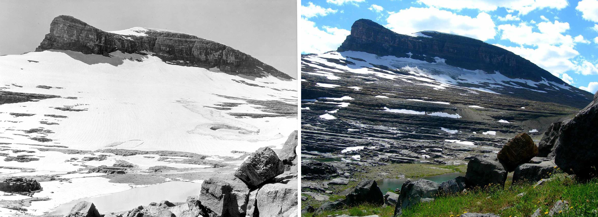
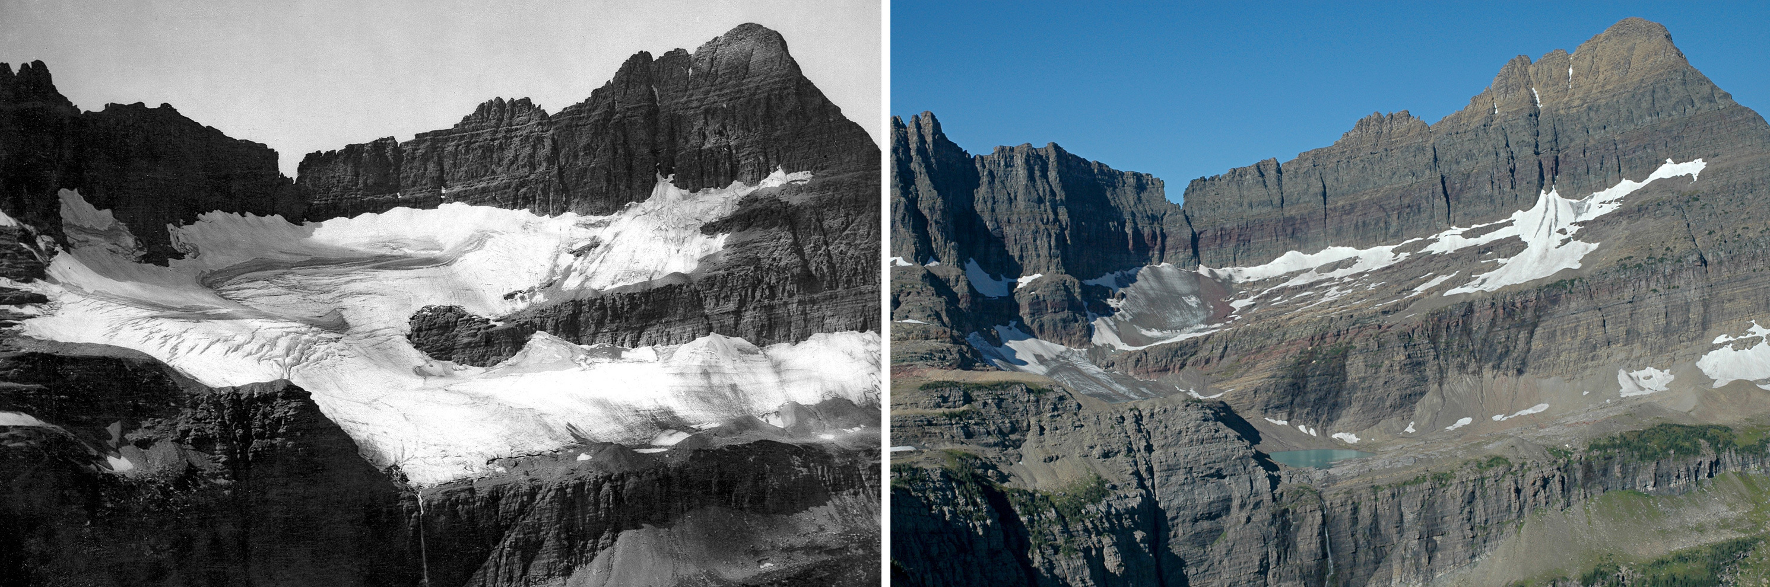
Trends – Climate & Hydrology
Warmer spring and winter temperatures causing earlier snowmelt
Higher streamflows in the fall indicative of glacial melt (Northern Rockies) and permafrost and rock glacier melt (Southern Rockies)
Area of alpine tundra climate classification in United States shrinking
Photos: T.J. Hileman and Greg Pederson
Baron et al 2000; Caine 2017; Clow et al 2006; Diaz and Eischeid 2007; Giersch et al 2016
Notes:
Now I’m going to jump into some preliminary trends I’m finding (at least in the first half of the alphabet, because I’m going through our Zotero database alphabetically)
We’ll start with climate and hydrology:
Scientists are recording warmer spring and winter temperatures causing earlier snowmelt, with melt even beginning before maximum snow levels are reached in the winter
Higher streamflows in the fall are being recorded and are indicative of glacial melt in the Northern Rockies and permafrost and rock glacier melt in the Southern Rockies
Finally, we’ve seen a decline in the area considered to be in the "alpine tundra" climate classification due to warmer mean temperatures during the warmest month of the year
These photos are from Glacier National Park, showing the same location in 1913 and then again in 2005, exhibit some of the glacial melt we’re seeing

Slide 8
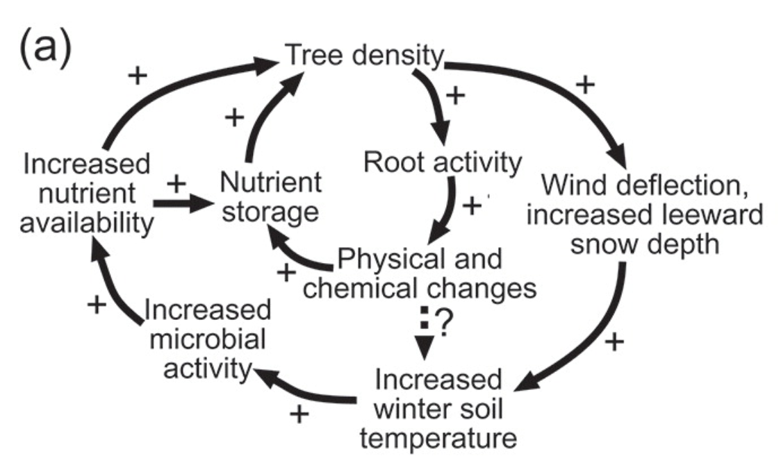
Trends - Treeline
Establishment and densification within the last 100 years
Patterns vary by location
  Positive feedback is the main driver of establishment in areas with more severe conditions
  Climate is the main driver of establishment when conditions are less severe
    Warmer temperatures in spring and fall and high summer precipitation promote establishment
Figure: Positive feedbacks promoting establishment at treeline (Bourgeron et al 2015).
Alftine et al 2013; Baker and Weisberg 1997; Bekker 2005; Elliott 2010, 2012, 2013; Hessl et al 1996; Klasner and Fagre 2018
Notes:
Treeline trends we’ve seen are a lot of establishment and densification/infill in the past 100 years
There are a couple drivers of this establishment:
In areas with more severe conditions (such as more northern latitudes and more northern aspects), positive feedbacks are the main driver
This figure from Bourgeron et al shows how complicated this feedback can get, but the key components are that trees that establish just above treeline create conditions for more trees to establish nearby by increasing snow accumulation which increases soil moisture and protecting seedlings from wind
In areas with less severe conditions (like more southern latitudes and southern aspects), climate is the main driver of establishment, with warmer temperatures in the spring and fall, and higher summer precipitation promoting establishment

Slide 9
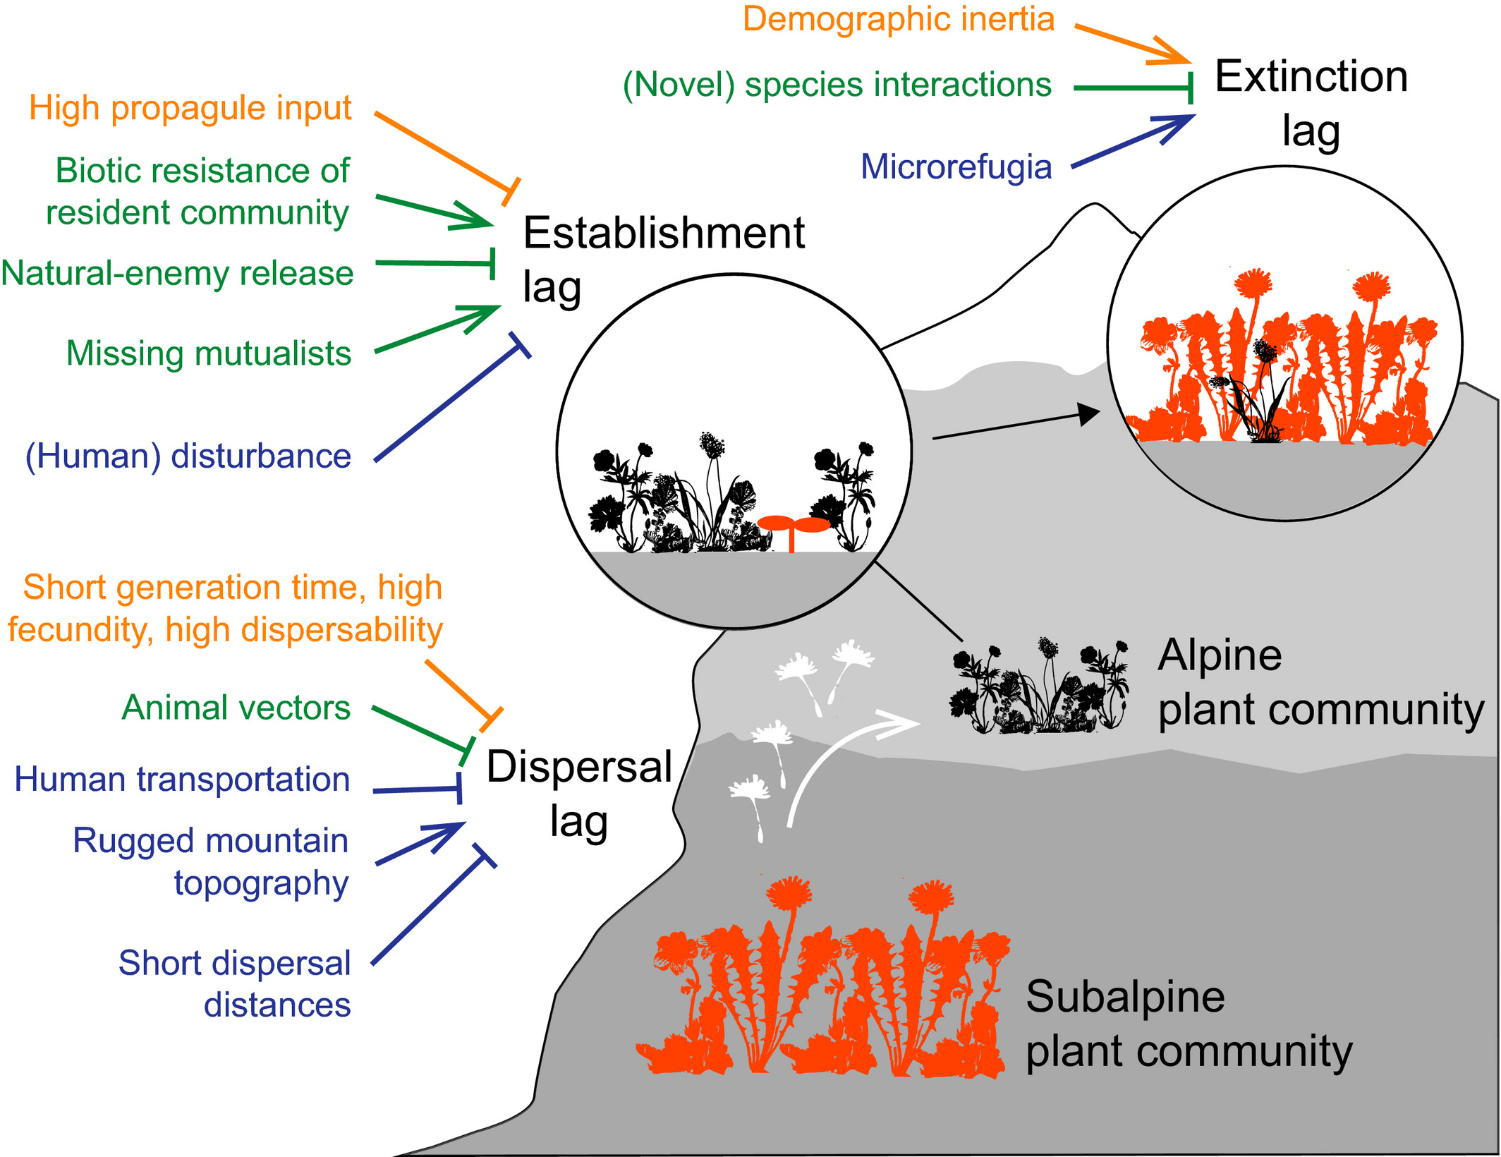
Trends - Vegetation
Overall, we’re seeing little change in alpine vegetation due to lags
  Except shrub expansion at Niwot
Predictions based on modeling and experiments:
  Warming will not cause increase in productivity without precipitation increases
  Longer snow-free season doesn’t lengthen growing season, just shifts phenology earlier
  Wet and dry communities will respond differently
  Some declines of marginal populations and species, but very individualistic responses
Figure: Lags present in alpine plant communities. Pointed arrows will increase and flat arrows will decrease the magnitude of lags. (Alexander et al 2017).
Baron et al 2000; Bueno de Mesquita et al 2018; Farrer et al 2014; Jabis et al 2020; Johnson et al 2011; Kueppers et al 2017; Lesica and McCune 2004; Lesica and Crone 2016
Notes:
Across all the literature I’ve read so far, the general consensus is that we’re seeing lags in vegetation response to climate change
Except for shrub expansion at Niwot Ridge, which most people attribute to a release from grazing, not just warming
This figure from Alexander et al highlights some of the mechanisms through which lags operate:
The three key types of lags are dispersal lags, where alpine vegetation hasn’t been able to disperse into newly suitable habitat due to dispersal limits such as rugged topography
There are also establishment lags, in which plants are unable to establish in newly suitable habitat due to things like the absence of necessary mutualists or biotic limitations like competition
Finally, there are extinction lags, which create extinction debt, and these lags can be caused by demographic inertia (like long-living perennial species), and microrefugia in the rugged mountain topography where conditions remain stable for individuals or populations
These lags all operate at the community level, not just the individual or species level, which is creating a guise of stability that is probably just extinction debt creating a tipping point waiting to happen
However, there are some predictions about alpine vegetation response to climate change from models and experiments:
Warming will not cause an increase in productivity unless there is also a precipitation increase
A longer snow-free season doesn’t actually lengthen the growing season, it just shifts phenology earlier
There will be a decoupling of wet and dry communities, meaning wet and dry alpine communities will respond differently to change
And there will be general declines in marginal populations and species, but overall species and populations may have very individualistic responses
Figure caption: The magnitude and pace of alpine plant community turnover with climate change will be influenced by rates of species dispersal from lower elevations (“dispersal lags”), their rates of establishment and population growth in alpine communities (“establishment lags”) and extinction rates of resident alpine species (“extinction lags”). We include factors highlighted by our review that will increase (pointed arrows) or decrease (flat arrows) the magnitude of lags (factors related to focal species physiology and demography, biotic interactions, and the physical environment coloured orange, green and blue, respectively, in the online version)

Slide 10
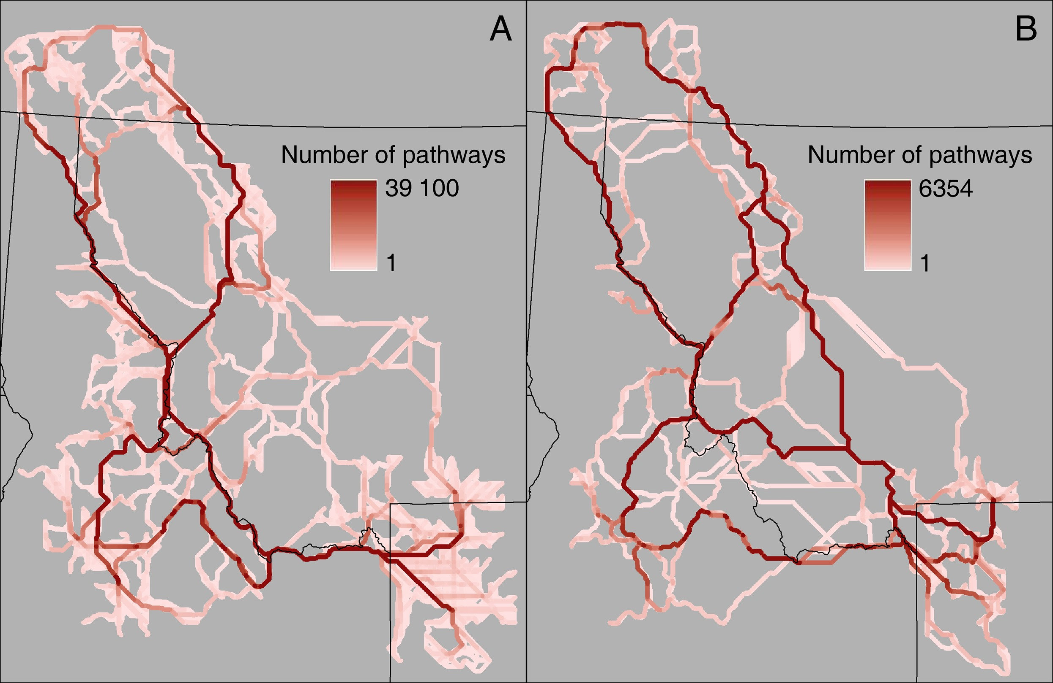
Trends - Wildlife
Wolverine: declines in winter snowpack may limit denning locations and habitat connectivity
Pika: declines in available forage at lower elevations, more extirpation at lower elevations at lower latitudes
Pollinators: individualistic responses
Hibernating/migrating species: generally earlier arrival and emergence due to warmer temperatures
Figure: Least-cost paths for wolverine movement for (A) the historical reconstruction and (B) the periods 2030-2059. Declines in (B) due to decreased habitat (McKelvey et al 2011).
Barsugli et al 2020; Bhattacharyya and Ray 2015; Billman et al 2021; Buckley and Kingsolver 2012; Galbreath et al 2009; Inouye et al 2000
Notes:
There’s not as much literature about wildlife response to climate change, but what I’ve read so far says:
That the decline in winter snowpack is impacting wolverines by limiting denning locations at lower elevations and habitat connectivity in general (as shown with this figure illustrating a future prediction of habitat connectivity for wolverines for 2030-2059)

Slide 11
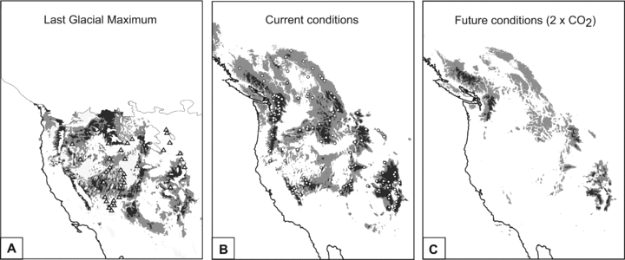
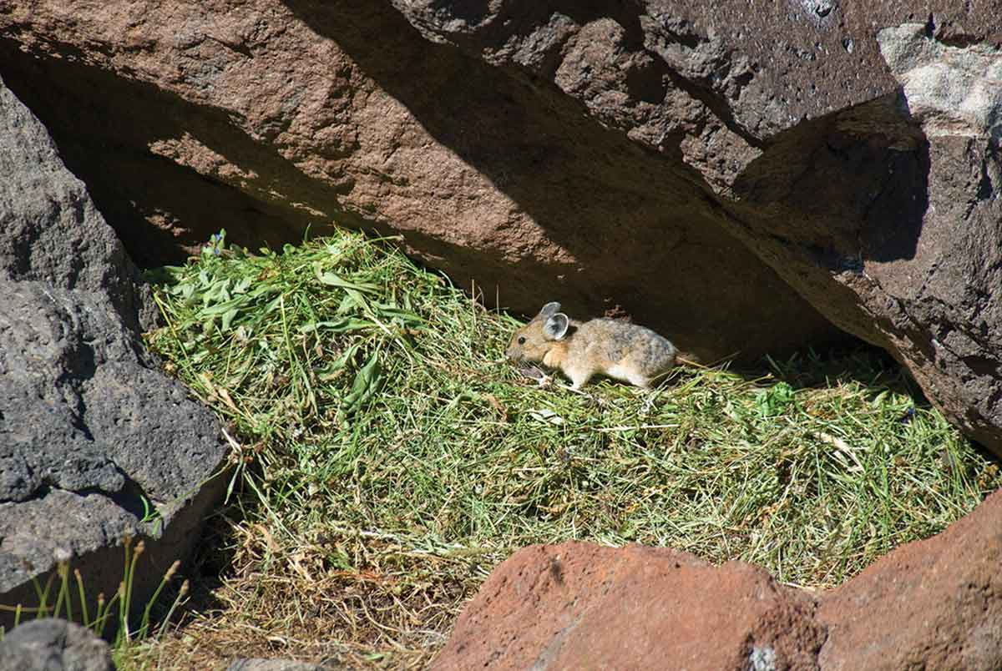
Trends - Wildlife
Figure: Ecological niche models showing predicted distribution of pika under (A) last glacial maximum, (B) current, and (C) future climatic conditions (Galbreath et al 2009).
Wolverine: declines in winter snowpack may limit denning locations and habitat connectivity
Pika: declines in available forage at lower elevations, more extirpation at lower elevations at lower latitudes
Pollinators: individualistic responses
Hibernating/migrating species: generally earlier arrival and emergence due to warmer temperatures
Barsugli et al 2020; Bhattacharyya and Ray 2015; Billman et al 2021; Buckley and Kingsolver 2012; Galbreath et al 2009; Inouye et al 2000
Photo: Rebecca Barkley
Notes:
We’re seeing the clearest examples of wildlife response to climate change in pika, with a decline in available forage and local extirpation at lower elevations at lower latitudes (like the southernmost parts of their range)
This figure shows ecological niche models of suitable pika habitat during the last glacial maximum on the left, current conditions in the middle, and future conditions on the right, and you can clearly see a vast reduction in suitable habitat for pika under future climate conditions
For pollinators, there isn’t a lot of literature, but generally there are more individualistic responses by species, so there isn’t really a consensus on climate change impacts for this group
Finally, at RMBL they’re seeing earlier arrival and emergence of migrating and hibernating species
This is problematic because they’re coming out early due to warmer temperatures, but then there is still decent snowpack, which makes it harder for them to find food
I also added this picture of a pika and it’s haypile because wow they are great foragers
Figure caption: Ecological niche models (ENM) showing the predicted distribution of Ochotona princeps under (A) last glacial maximum (LGM), (B) current, and (C) future climatic conditions. Distributions are shown at 0.1 (light gray) and 0.5 (dark gray) probability thresholds. The visible area in all maps is 103° to 130° W and 30° to 60° N. Note that the continental margin depicted on the LGM map differs from the others because sea levels were lower during glacial periods. On the LGM map, the approximate extent of the continental ice sheet and montane glaciers (Péwé 1983; Porter et al. 1983) and full-pluvial lakes (Baker 1983; Smith and Street-Perrott 1983) are masked in white. Open triangles indicate fossil pika localities that date to the Late Pleistocene and Holocene (Mead 1987; Hafner 1993; Grayson 2005). On the current conditions map, open circles indicate localities used to train and test the ENM.

Slide 12
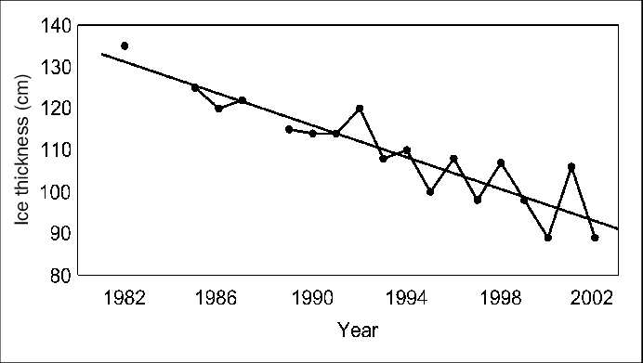
Trends – alpine lakes
Ice thickness on alpine lakes is thinning
Warmer surface water temperatures
Higher concentrations of major ions from rock glacier melt
Changes in phytoplankton community species composition
Lots of folks who study lakes have N-Z last names…
Figure: Ice thickness on Green Lake Four from 1982-2002 (Caine 2002).
Caine 2002; Flanagan et al 2008
Notes:
Finally we have trends in alpine lakes, and these are only from a few papers, but we’re seeing:
A decline in ice thickness on alpine lakes at Niwot due to increased snow cover creating insulation
There are also warmer surface water temperatures in lakes at Niwot due to warmer air temperatures
Rock glaciers are melting from higher temperatures, which leads to high concentrations of major ions from weathering in lake water
There has also been a change in phytoplankton community species composition due to those higher surface water temperatures
However, there seem to be a lot of folks with N-Z last names that study lakes, so there are several papers about climate change and alpine lakes that I haven’t gotten to yet
Figure caption: Ice thickness (in centimeters) for an alpine lake, Green Lake Four, located in the Colorado Front Range. Although ambient temperatures have not significantly changed, ice depth and duration are on the decline. Updated from Caine (2002).

Slide 13
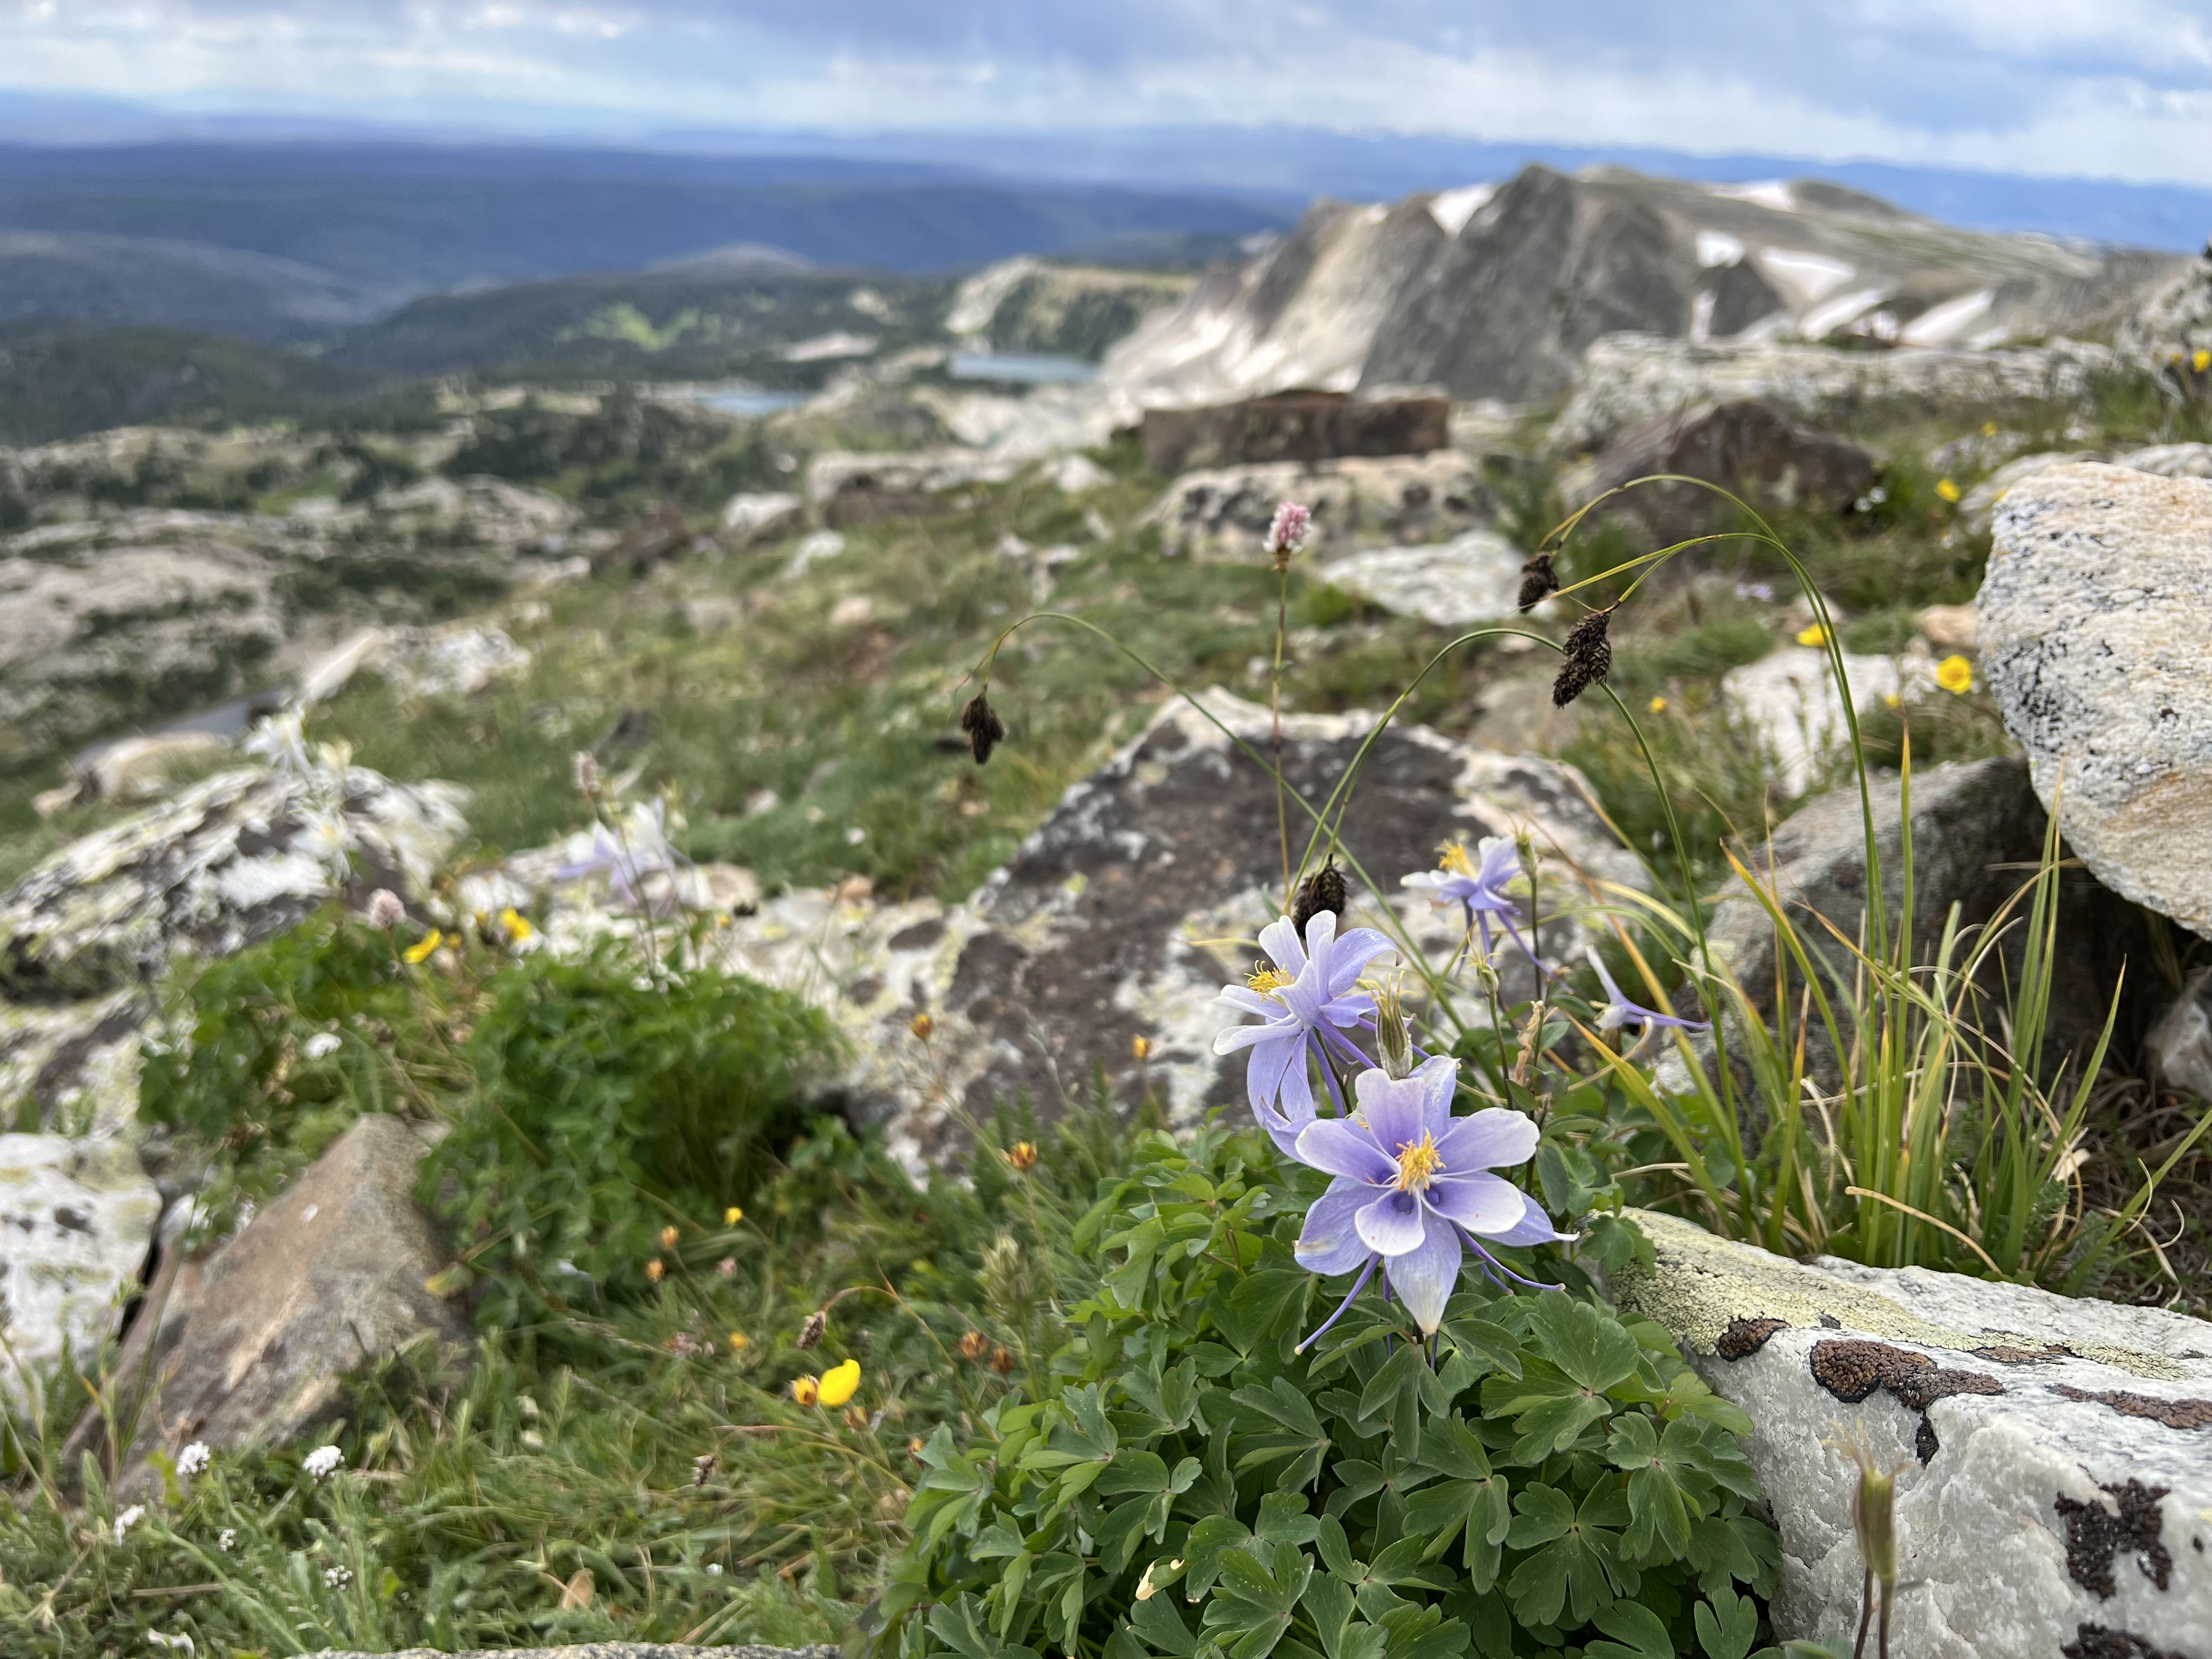
General trends
Lots of site-specific and individualistic responses
Observational empirical examples of climate change impacts primarily in treeline, pika, and snowpack/streamflows
  Thus far, few empirical examples of climate change impacts on vegetation and other wildlife due to lags
With vegetation and alpine lakes specifically, lots of hinting at a tipping point we haven’t reached yet
Photo: A. Ennis
Notes:
So for general trends, there are a lot of site-specific and individualistic responses, which adds to speculation about if it is appropriate to extrapolate trends across alpine systems generally
There have been observational empirical examples of climate change impacts on treeline, pika, and snowpack/streamflows, but less so on vegetation and wildlife
This is due to those lags that I talked about, and also high variability in mountain systems, which creates stability --> both of these cause the creation of a tipping point where we could see vegetation and wildlife communities collapse kind of all at once when our extinction debt is owed all at the same time

Slide 14
Next steps & products
Parts 2 & 3 of the project
  Synthesizing climate adaptation strategies and partner needs and challenges
  Producing initiative for climate adaptation research in mountain systems
2-pager
Manuscript
AGU presentation
Notes:
These are the next steps

Slide 15
Key stakeholders
Water managers
National Park Service
Conservation groups (i.e. Denver Botanic Garden)
Anyone interested in the water, biodiversity, and recreation opportunities provided by the alpine

Slide 16
references
Alftine, K. J., Malanson, G. P., & Fagre, D. B. (2003). Feedback-Driven Response to Multidecadal Climatic Variability at an Alpine Treeline. Physical Geography, 24(6), 520–535. https://doi.org/10.2747/0272-3646.24.6.520
Baker, W., & Weisberg, P. (1997). Using GIS to model tree population parameters in the Rocky Mountain National Park forest–tundra ecotone. Journal of Biogeography, 24(4), 513–526. https://doi.org/10.1111/j.1365-2699.1997.00130.x
Baron, J. S., Hartman, M. D., Band, L. E., & Lammers, R. B. (2000). Sensitivity of a high-elevation rocky mountain watershed to altered climate and CO2. Water Resources Research, 36(1), 89–99. https://doi.org/10.1029/1999WR900263
Baron, J. S., Schmidt, T. M., & Hartman, M. D. (2009). Climate-induced changes in high elevation stream nitrate dynamics. Global Change Biology, 15(7), 1777–1789. https://doi.org/10.1111/j.1365-2486.2009.01847.x
Barsugli, J. J., Ray, A. J., Livneh, B., Dewes, C. F., Heldmyer, A., Rangwala, I., Guinotte, J. M., & Torbit, S. (2020). Projections of Mountain Snowpack Loss for Wolverine Denning Elevations in the Rocky Mountains. Earth’s Future, 8(10), e2020EF001537. https://doi.org/10.1029/2020EF001537
Bekker, M. F. (2005). Positive Feedback Between Tree Establishment and Patterns of Subalpine Forest Advancement, Glacier National Park, Montana, U.S.A. Arctic, Antarctic, and Alpine Research, 37(1), 97–107. https://doi.org/10.1657/1523-0430(2005)037[0097:PFBTEA]2.0.CO;2
Bhattacharyya, S., & Ray, C. (2015). Of plants and pikas: Evidence for a climate-mediated decline in forage and cache quality. Plant Ecology & Diversity, 8(5–6), 781–794. https://doi.org/10.1080/17550874.2015.1121520
Billman, P. D., Beever, E. A., McWethy, D. B., Thurman, L. L., & Wilson, K. C. (2021). Factors influencing distributional shifts and abundance at the range core of a climate-sensitive mammal. Global Change Biology, 27(19), 4498–4515. https://doi.org/10.1111/gcb.15793
Buckley, L. B., & Kingsolver, J. G. (2012). The demographic impacts of shifts in climate means and extremes on alpine butterflies. Functional Ecology, 26(4), 969–977. https://doi.org/10.1111/j.1365-2435.2012.01969.x
Bueno de Mesquita, C. P., Tillmann, L. S., Bernard, C. D., Rosemond, K. C., Molotch, N. P., & Suding, K. N. (2018). Topographic heterogeneity explains patterns of vegetation response to climate change (1972–2008) across a mountain landscape, Niwot Ridge, Colorado. Arctic, Antarctic, and Alpine Research, 50(1), e1504492. https://doi.org/10.1080/15230430.2018.1504492
Caine, N. (2002). Declining Ice Thickness on an Alpine Lake is Generated by Increased Winter Precipitation. Climatic Change, 54(4), 463–470. https://doi.org/10.1023/A:1016111810814
Caine, N. (2010). Recent hydrologic change in a Colorado alpine basin: An indicator of permafrost thaw? Annals of Glaciology, 51(56), 130–134. https://doi.org/10.3189/172756411795932074
Clow, D. w., Schrott, L., Webb, R., Campbell, D. h., Torizzo, A., & Dornblaser, M. (2003). Ground Water Occurrence and Contributions to Streamflow in an Alpine Catchment, Colorado Front Range. Groundwater, 41(7), 937–950. https://doi.org/10.1111/j.1745-6584.2003.tb02436.x
Diaz, H. F., & Eischeid, J. K. (2007). Disappearing “alpine tundra” Köppen climatic type in the western United States. Geophysical Research Letters, 34(18). https://doi.org/10.1029/2007GL031253
Elliott, G. P. (2011). Influences of 20th-century warming at the upper tree line contingent on local-scale interactions: Evidence from a latitudinal gradient in the Rocky Mountains, USA. Global Ecology and Biogeography, 20(1), 46–57. https://doi.org/10.1111/j.1466-8238.2010.00588.x

Slide 17
references
Elliott, G. P. (2012a). Extrinsic regime shifts drive abrupt changes in regeneration dynamics at upper treeline in the Rocky Mountains, USA. Ecology, 93(7), 1614–1625. https://doi.org/10.1890/11-1220.1
Elliott, G. P. (2012b). The Role of Thresholds and Fine-Scale Processes in Driving Upper Treeline Dynamics in the Bighorn Mountains, Wyoming. Physical Geography, 33(2), 129–145. https://doi.org/10.2747/0272-3646.33.2.129
Farrer, E. C., Ashton, I. W., Spasojevic, M. J., Fu, S., Gonzalez, D. J. X., & Suding, K. N. (2015). Indirect effects of global change accumulate to alter plant diversity but not ecosystem function in alpine tundra. Journal of Ecology, 103(2), 351–360. https://doi.org/10.1111/1365-2745.12363
Flanagan, C. M., McKnight, D. M., Liptzin, D., Williams, M. W., & Miller, M. P. (2009). Response of the Phytoplankton Community in an Alpine Lake to Drought Conditions: Colorado Rocky Mountain Front Range, U.S.A. Arctic, Antarctic, and Alpine Research, 41(2), 191–203. https://doi.org/10.1657/1938.4246-41.2.191
Galbreath, K. E., Hafner, D. J., & Zamudio, K. R. (2009). WHEN COLD IS BETTER: CLIMATE-DRIVEN ELEVATION SHIFTS YIELD COMPLEX PATTERNS OF DIVERSIFICATION AND DEMOGRAPHY IN AN ALPINE SPECIALIST (AMERICAN PIKA, OCHOTONA PRINCEPS). Evolution, 63(11), 2848–2863. https://doi.org/10.1111/j.1558-5646.2009.00803.x
Giersch, J. J., Hotaling, S., Kovach, R. P., Jones, L. A., & Muhlfeld, C. C. (2017). Climate-induced glacier and snow loss imperils alpine stream insects. Global Change Biology, 23(7), 2577–2589. https://doi.org/10.1111/gcb.13565
Hessl, A. E., Weisberg, P. J., & Baker, W. L. (1996). Spatial Variability of Radial Growth in the Forest-Tundra Ecotone of Rocky Mountain National Park, Colorado. Bulletin of the Torrey Botanical Club, 123(3), 206–212. https://doi.org/10.2307/2996796
Inouye, D. W., Barr, B., Armitage, K. B., & Inouye, B. D. (2000). Climate change is affecting altitudinal migrants and hibernating species. Proceedings of the National Academy of Sciences, 97(4), 1630–1633. https://doi.org/10.1073/pnas.97.4.1630
Jabis, M. D., Winkler, D. E., & Kueppers, L. M. (2020). Warming acts through earlier snowmelt to advance but not extend alpine community flowering. Ecology, 101(9), e03108. https://doi.org/10.1002/ecy.3108
Johnson, D. R., Ebert-May, D., Webber, P. J., & Tweedie, C. E. (2011). Forecasting Alpine Vegetation Change Using Repeat Sampling and a Novel Modeling Approach. AMBIO, 40(6), 693–704. https://doi.org/10.1007/s13280-011-0175-z
Klasner, F. L., & Fagre, D. B. (2002). A Half Century of Change in Alpine Treeline Patterns at Glacier National Park, Montana, U.S.A. Arctic, Antarctic, and Alpine Research, 34(1), 49–56. https://doi.org/10.1080/15230430.2002.12003468
Kueppers, L. M., Conlisk, E., Castanha, C., Moyes, A. B., Germino, M. J., de Valpine, P., Torn, M. S., & Mitton, J. B. (2017). Warming and provenance limit tree recruitment across and beyond the elevation range of subalpine forest. Global Change Biology, 23(6), 2383–2395. https://doi.org/10.1111/gcb.13561
Lesica, P., & Crone, E. E. (2017). Arctic and boreal plant species decline at their southern range limits in the Rocky Mountains. Ecology Letters, 20(2), 166–174. https://doi.org/10.1111/ele.12718
Lesica, P., & McCune, B. (2004). Decline of arctic-alpine plants at the southern margin of their range following a decade of climatic warming. Journal of Vegetation Science, 15(5), 679–690. https://doi.org/10.1111/j.1654-1103.2004.tb02310.x

