Slide 1
Rapid ecological change and transformation across the Middle and Southern Rockies during a previous climate warming
Shelley Crausbay^{1, 2, 3}, Amanda Kissel¹, Patrick Freeman¹, and Wynne Moss^{1, 2, 4}
¹Conservation Science Partners, ²North Central Climate Adaptation Science Center, ³USFS, ⁴USGS

Slide 2
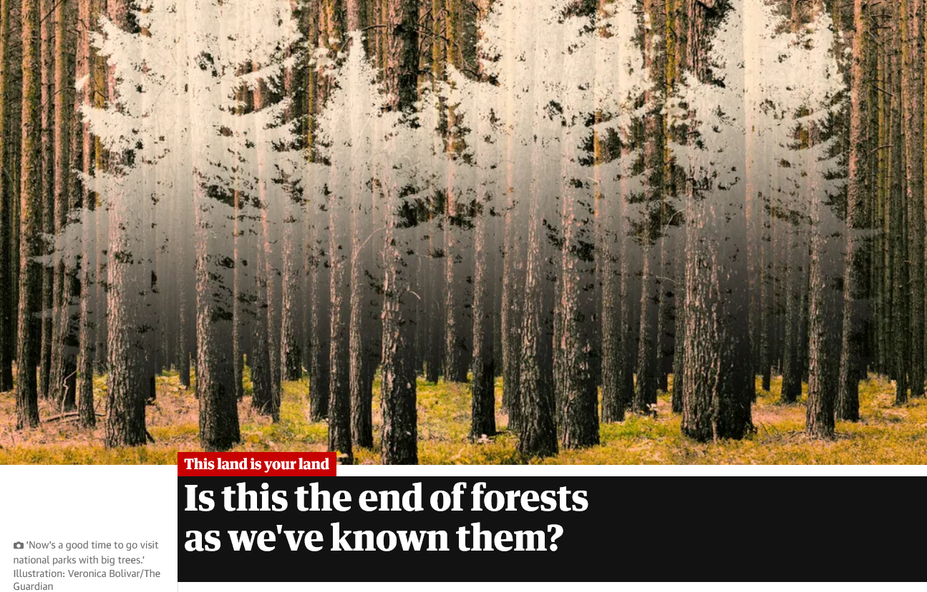

Slide 3
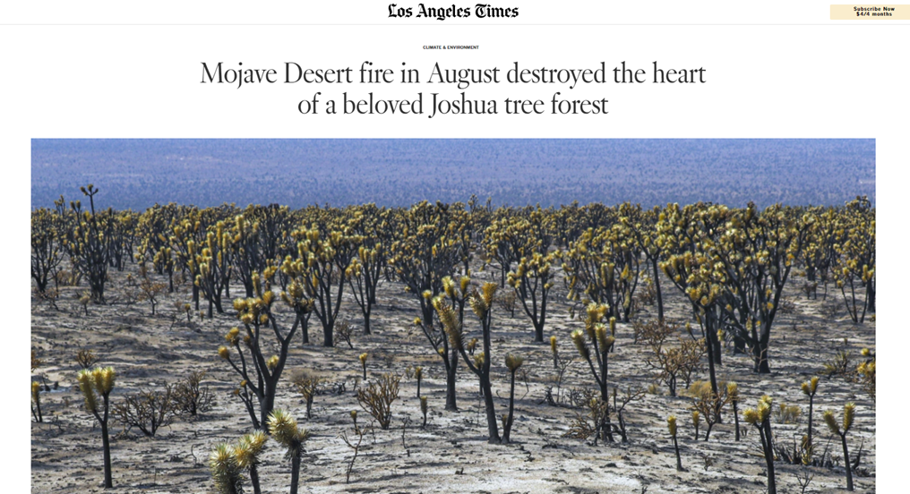

Slide 4
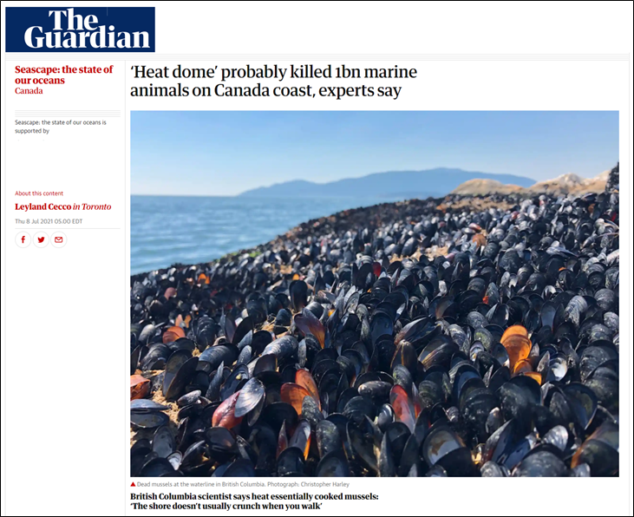

Slide 5
ECOLOGICAL TRANSFORMATION:
the dramatic and irreversible shift in multiple ecological characteristics of an ecosystem, the basis of which is a high degree of turnover in ecological communities
Crausbay et al. 2022 BioScience

Slide 6
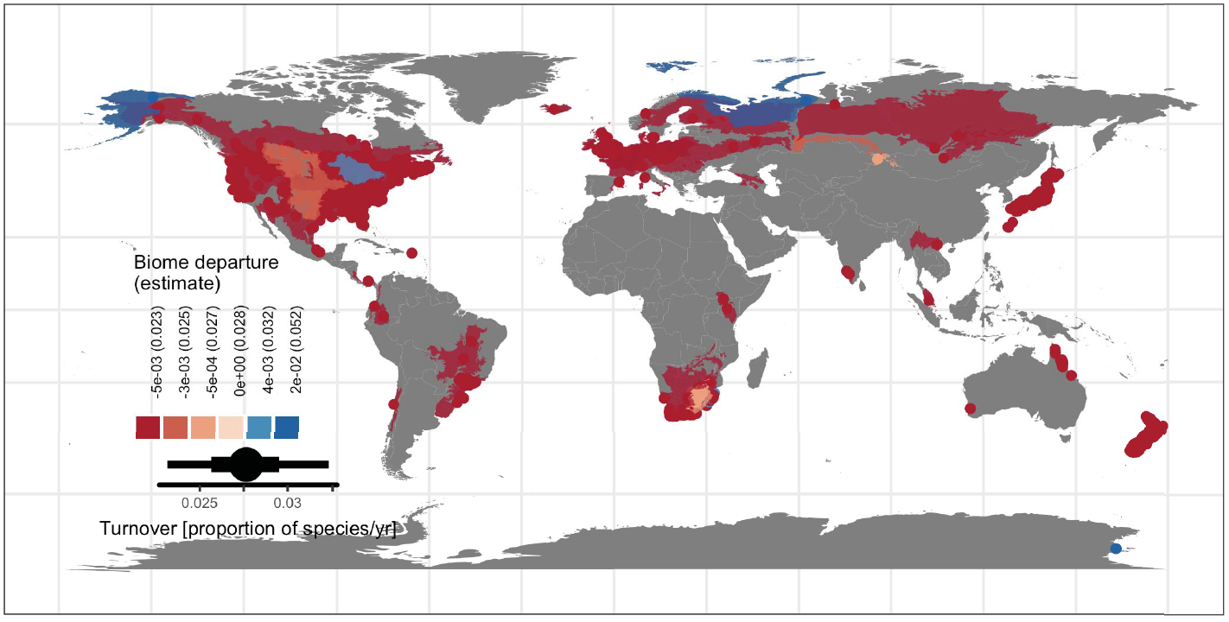
Turnover in ecological communities
median 28% of species replaced / decade
Blowes et al. 2019 Science

Slide 7
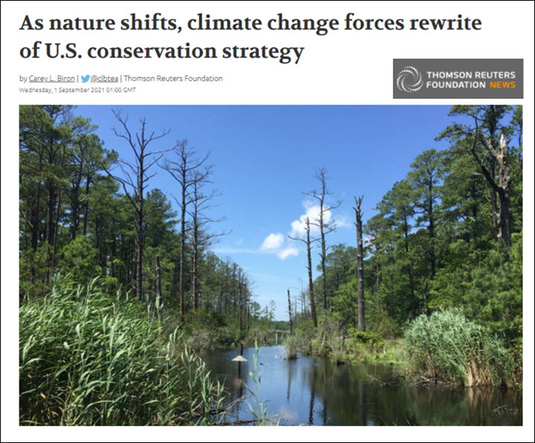

Slide 8
Recent adaptation typologies focus on transformation

Slide 9
Making decisions about transformation
Crausbay et al. 2022 BioScience

Slide 10
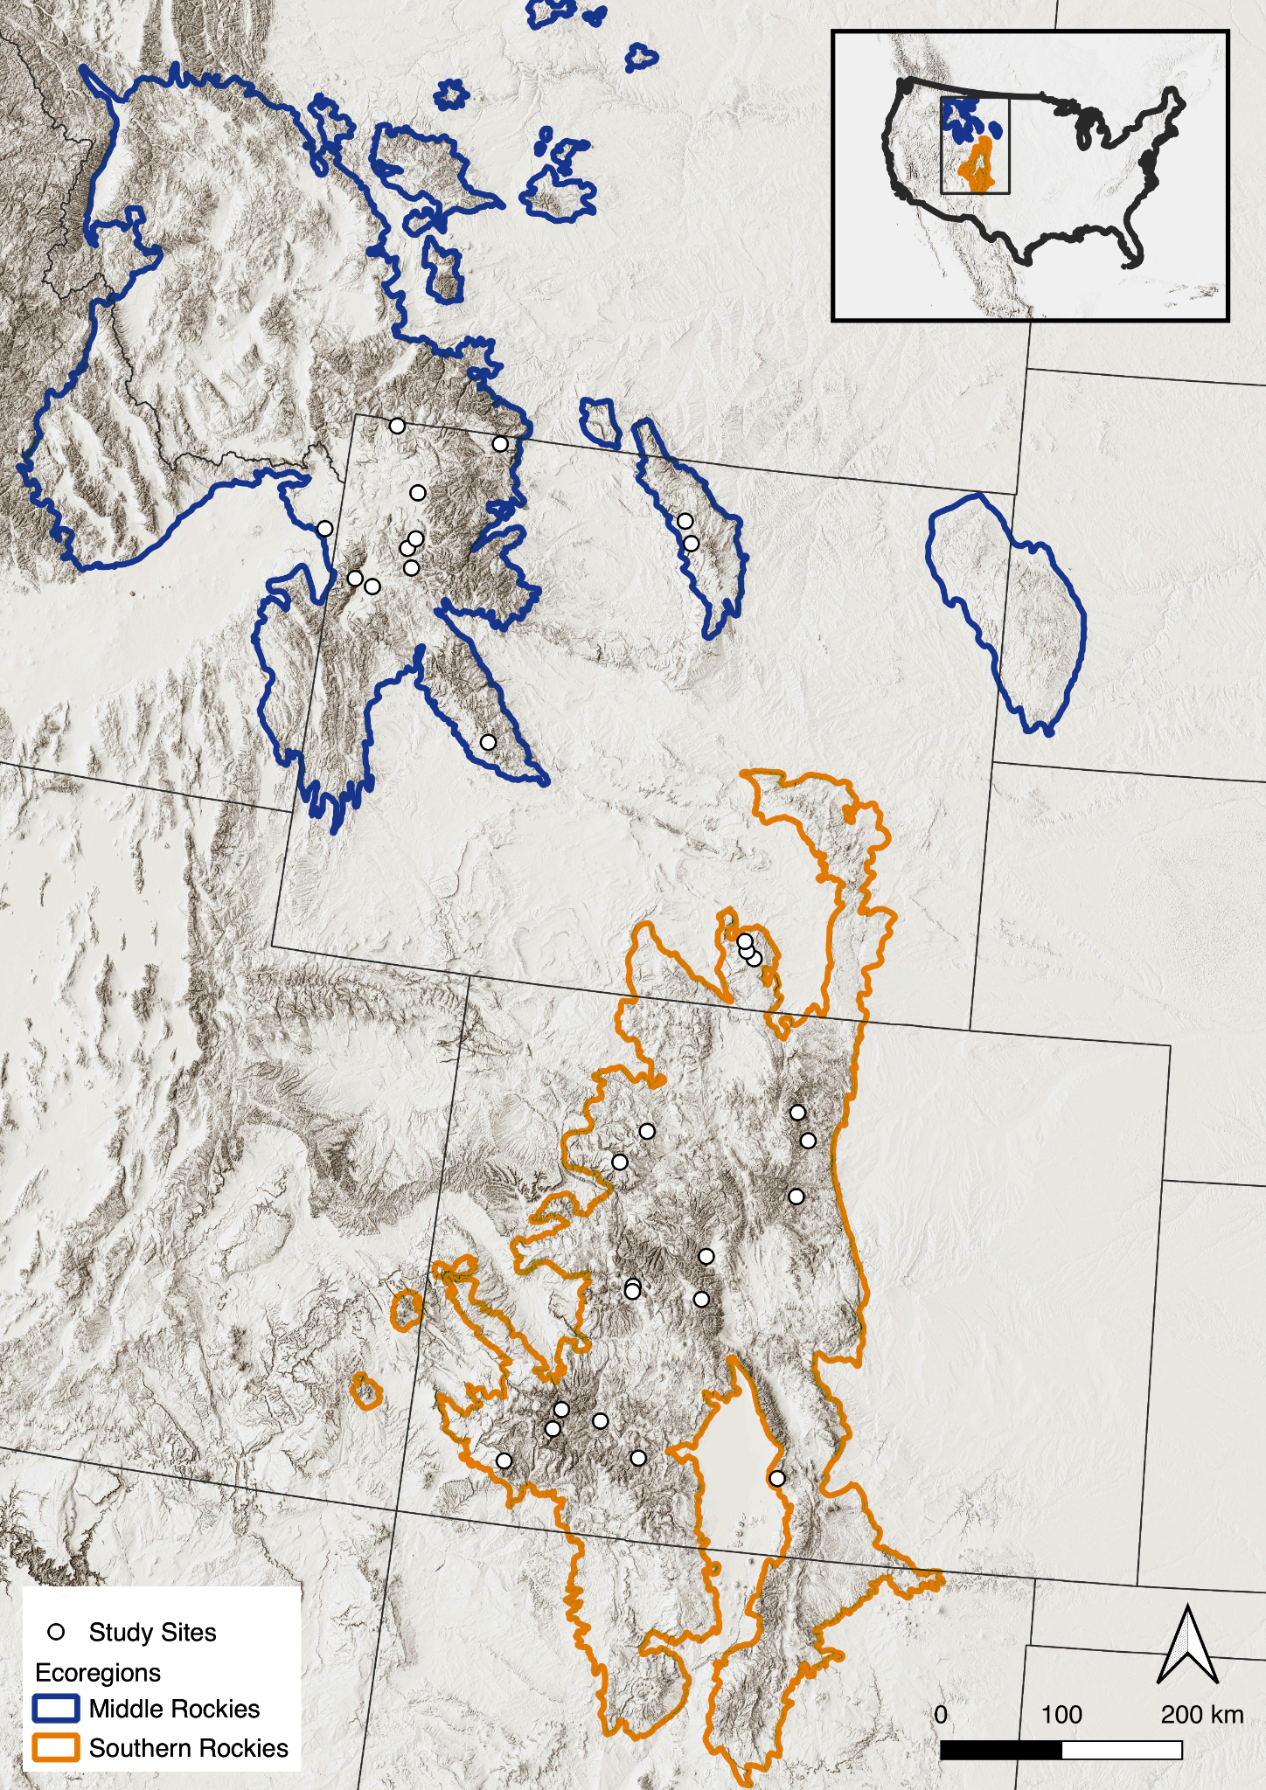
Is transformation a threat to ecosystems in the Rockies?
Where?
When?
How quickly will the transition go?
What will the system transform into?
What happened during a previous climate warming?

Slide 11
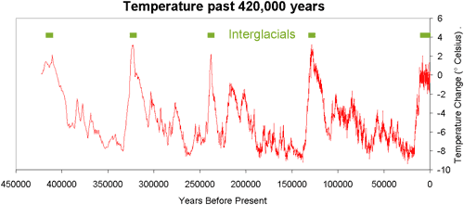
Many previous rapid warmings

Slide 12
OUTLINE
Paleoecological methods
History of transformation and rates of ecological change
Role of past climate change
Role of landscape features
Nature of ecological trajectories
Future implications

Slide 14
Paleorecords of vegetation change and transformation
Find moments of transformation
Moments of transformation
Artwork by Milan Teunissen van Manen (@MilanTvM).

Slide 15
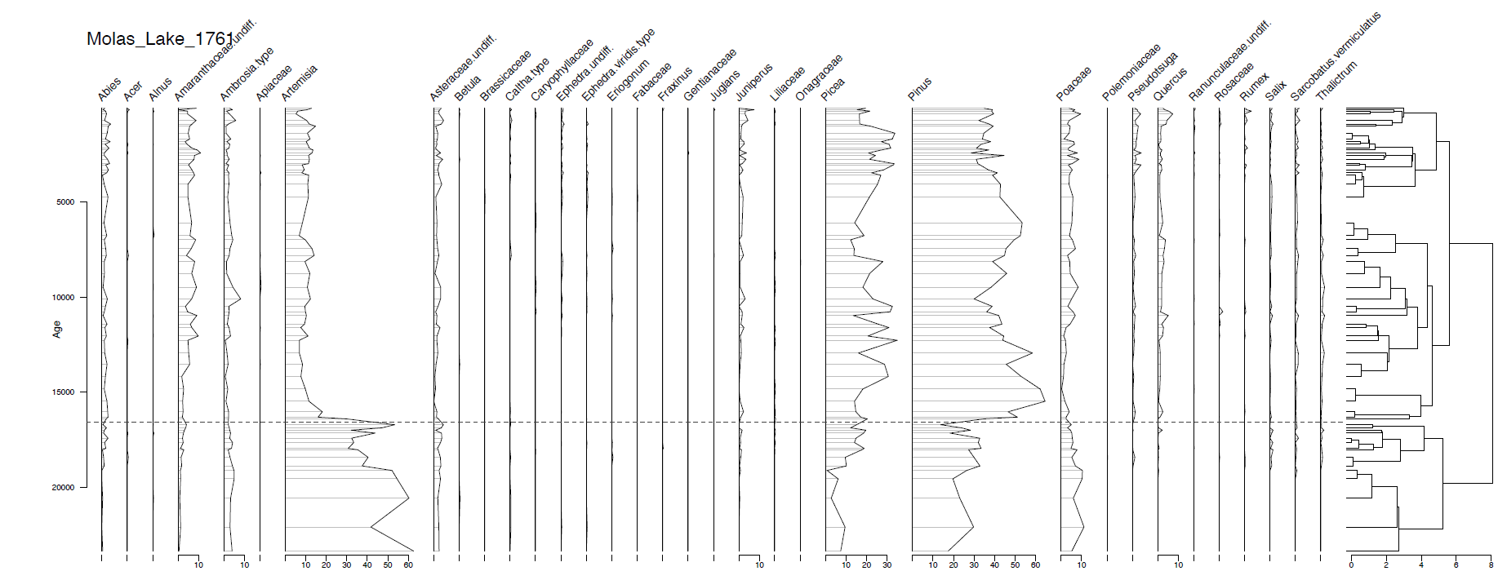
Paleorecords of vegetation change and transformation
Rate of change

Slide 16
Rapid and slow transformations
One rapid transformation
Two slow and one rapid transformations

Slide 17
Gather pollen and geochronology data
Neotoma API
Develop new age-depth models
Bayesian | ‘rbacon’
Harmonize taxonomies, standardize counts
Calculate ecological difference over time
Bray-Curtis distance measure
Identify transformations
Cluster analysis w/ broken stick | expert opinion
Measure rates of ecological change
distance/time | moving window | temporal uncertainty | ‘rratepol’
Identify peak rates of ecological change
‘rratepol’ | GAM

Slide 18
OUTLINE
Paleoecological methods
History of transformation and rates of ecological change
Role of past climate change
Role of landscape features
Nature of ecological trajectories
Future implications

Slide 19
Paleorecords of vegetation change and transformation

Slide 20
Number of transformations
Across 29 sites:
# unique transformations: 60
# transformation types (what to what): 21
# transformations per site: 1 - 4
12
10
8
6
4
3
2
0
# sites that did not transform: 0
# Sites
0 1 2 3 4
# Transformations

Slide 22
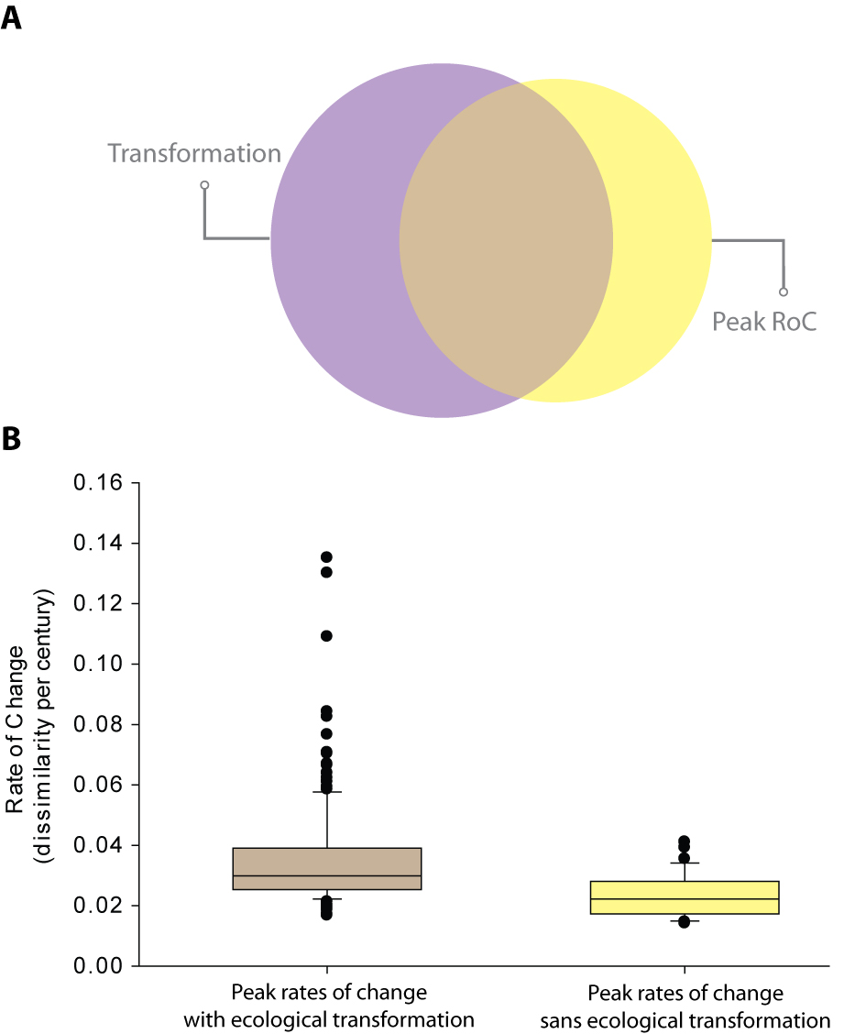

Slide 23
Landscape-scale change and transformation

Slide 24
OUTLINE
Paleoecological methods
History of transformation and rates of ecological change
Role of past climate change
Role of landscape features
Nature of ecological trajectories
Future implications

Slide 25
Modeled paleoclimate data
TraCE-21ka | CCSM3
Paleoclimate data
Anomalies, Trends, Variability | 100-yr time steps | ‘StableClim’
Modeling approach
Boosted Regression Trees | ‘dismo’

Slide 26
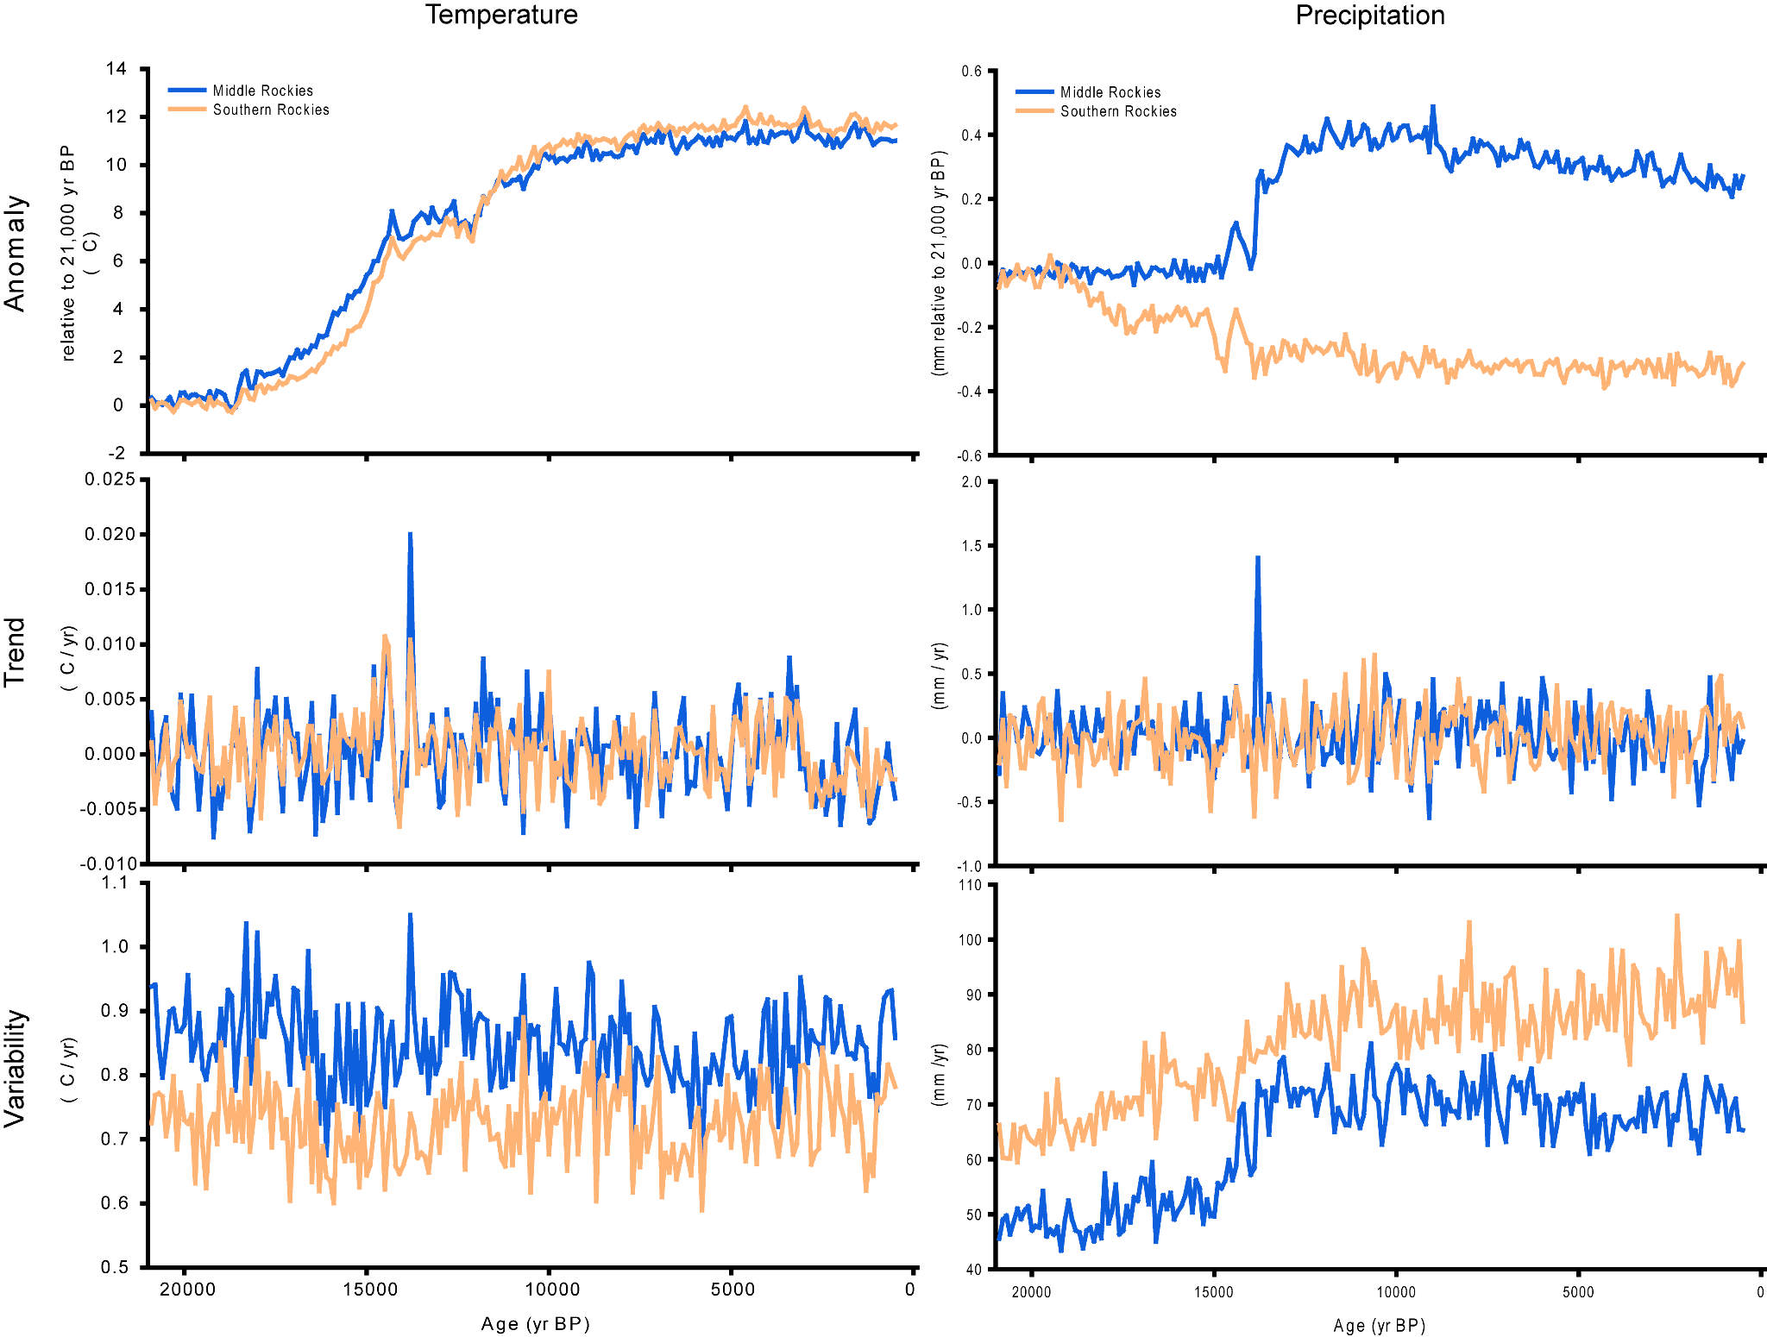
Paleoclimate -- TraCE-21ka via StableClim

Slide 27
Landscape-scale change and transformation

Slide 28
Boosted Regression Tree Models -- RoC
pseudo-R2 = 0.75
Rapid ecological change was initiated on a landscape scale with 2 ℃ warming

Slide 29
Boosted Regression Tree Models -- Transformation
pseudo-R2 = 0.75
pseudo-R2 = 0.5
Transformation was initiated on a landscape scale with 5-6 ℃ warming

Slide 30
Boosted Regression Tree Models – RoC since 7,500 yrs ago

Slide 31
Boosted Regression Tree Models – RoC since 7,500 yrs ago
pseudo-R2 = 0.63

Slide 32
OUTLINE
Paleoecological methods
History of transformation and rates of ecological change
Role of past climate change
Role of landscape features
Nature of ecological trajectories
Future implications

Slide 33
Calculate landscape metrics in ‘donuts’
Elevation | CHILI | slope | TPI | Aspect
Modeling approach
Each site’s RoC | Bayesian

Slide 34
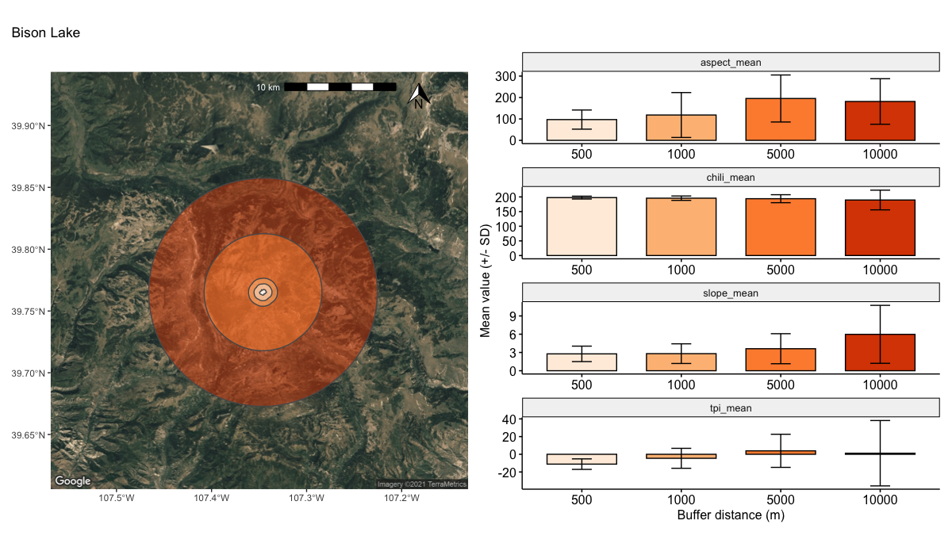
Landscape metrics

Slide 35
Rate of change -- all records

Slide 36
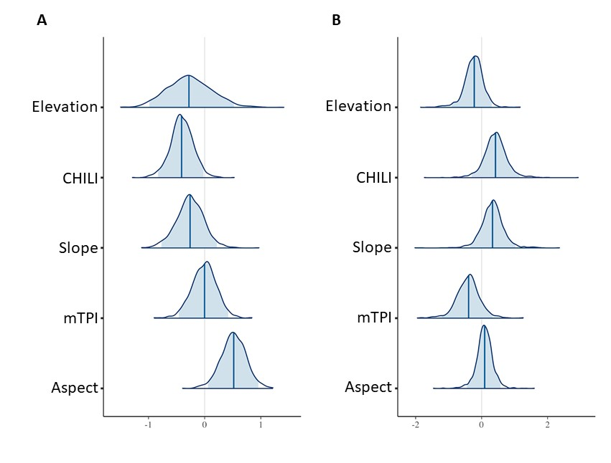
Weak effects of landscape variables
Southern Rockies
Middle Rockies
Notes:
Coefficient plots from Bayesian models describing how landscape characteristics drive rapid vegetation change at the site level. Each distribution represents the coefficient estimates from the posterior distribution of the model. The solid blue line represents the median coefficient estimate and the shaded blue regions represent the 95% credible intervals. Models of rate of vegetation change in the Southern Rockies shows a fairly strong positive effect of aspect, and potentially CHILI, and weak effects of other landscape features (A) and models in the Middle Rockies show only weak effects of landscape features, the heat loading index CHILI being the strongest (least overlap with 0) (B).

Slide 37
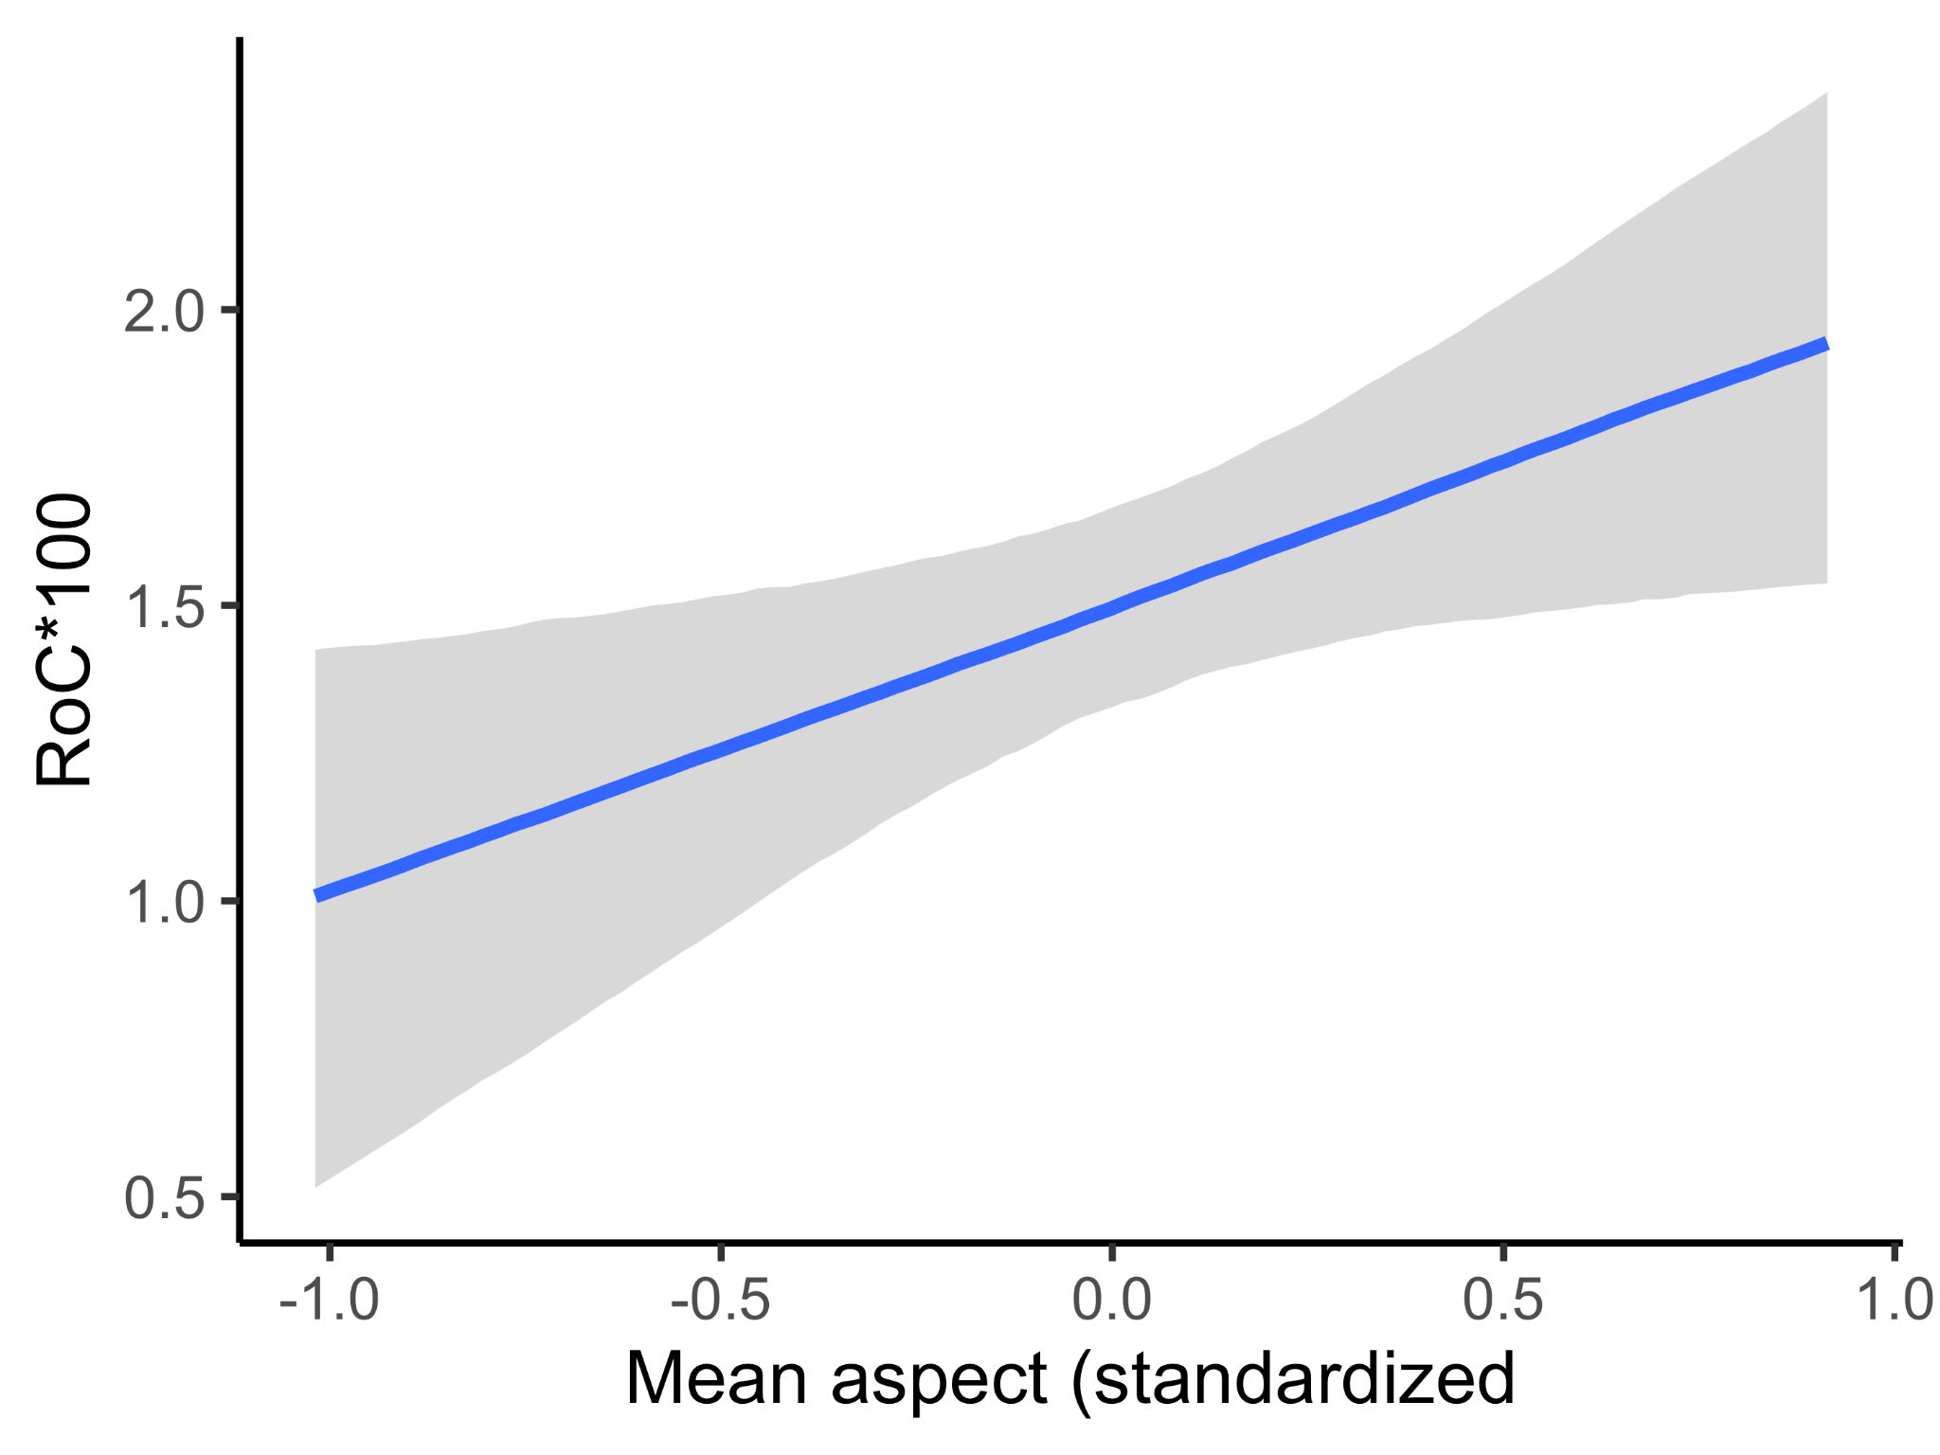
Aspect and ecological rates of change
southwesterly slopes
Notes:
Coefficient plots from Bayesian models describing how landscape characteristics drive rapid vegetation change at the site level. Each distribution represents the coefficient estimates from the posterior distribution of the model. The solid blue line represents the median coefficient estimate and the shaded blue regions represent the 95% credible intervals. Models of rate of vegetation change in the Southern Rockies shows a fairly strong positive effect of aspect, and potentially CHILI, and weak effects of other landscape features (A) and models in the Middle Rockies show only weak effects of landscape features, the heat loading index CHILI being the strongest (least overlap with 0) (B).

Slide 38
OUTLINE
Paleoecological methods
History of transformation and rates of ecological change
Role of past climate change
Role of landscape features
Nature of ecological trajectories
Future implications

Slide 39
Identify type of vegetation switch
Indicator Species Analysis | expert opinion
Identify site-level ecological trajectories
Trajectories out of Late Glacial Sagebrush | ‘ecotraj’

Slide 40
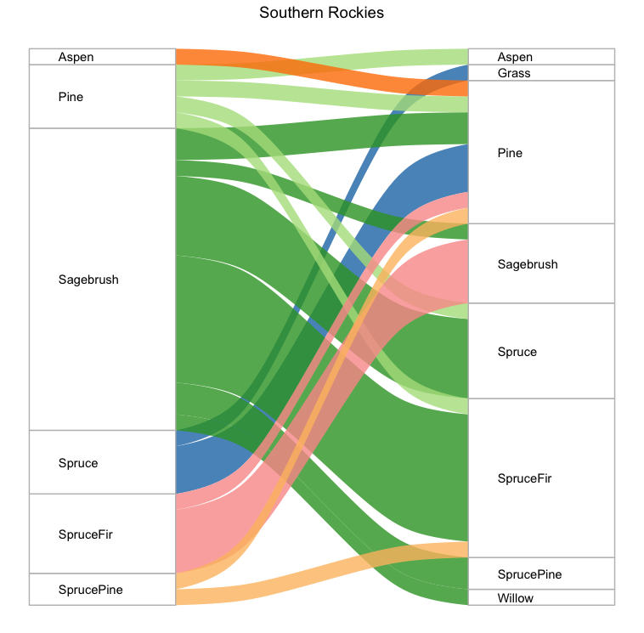
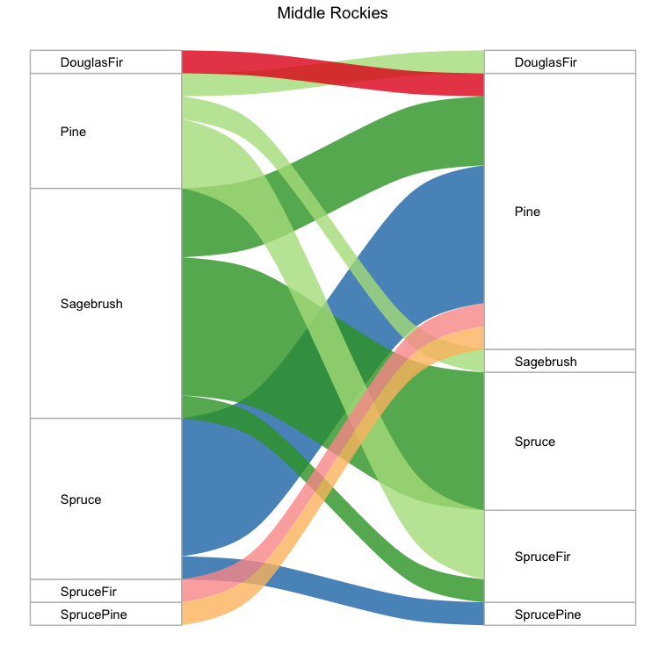
Types of transformations

Slide 41
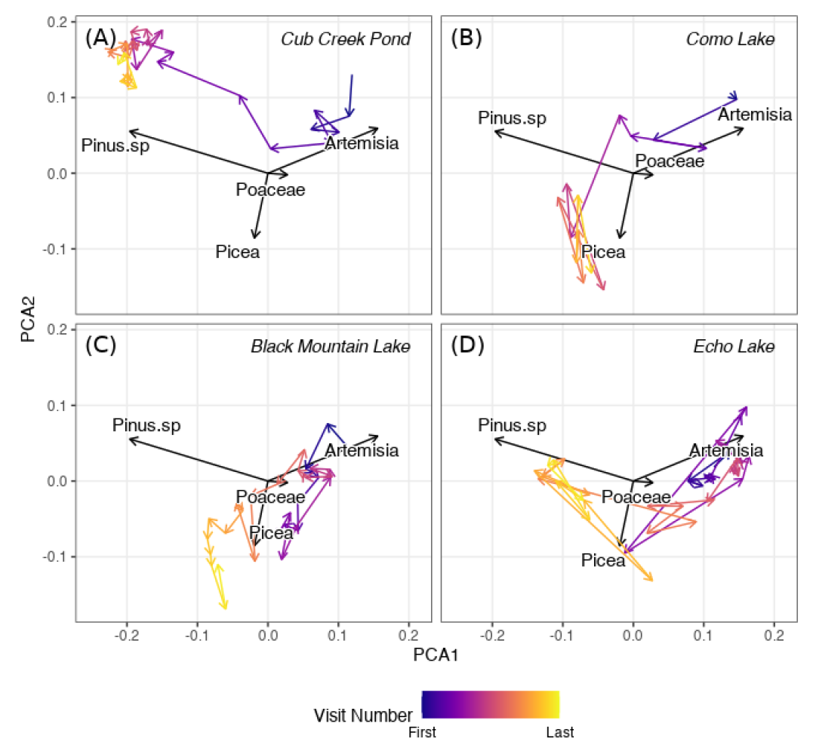
Ecological trajectories out of Late Glacial Sagebrush

Slide 42
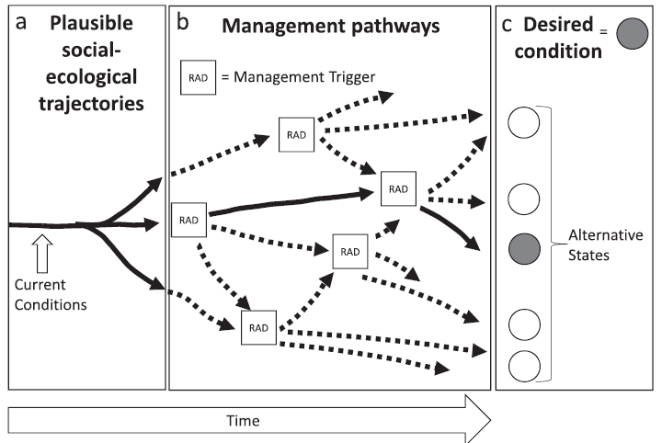
Ecological trajectories for adaptation
Magness et al. 2021 BioScience

Slide 43
OUTLINE
Paleoecological methods
History of transformation and rates of ecological change
Role of past climate change
Role of landscape features
Nature of ecological trajectories
Future implications

Slide 44
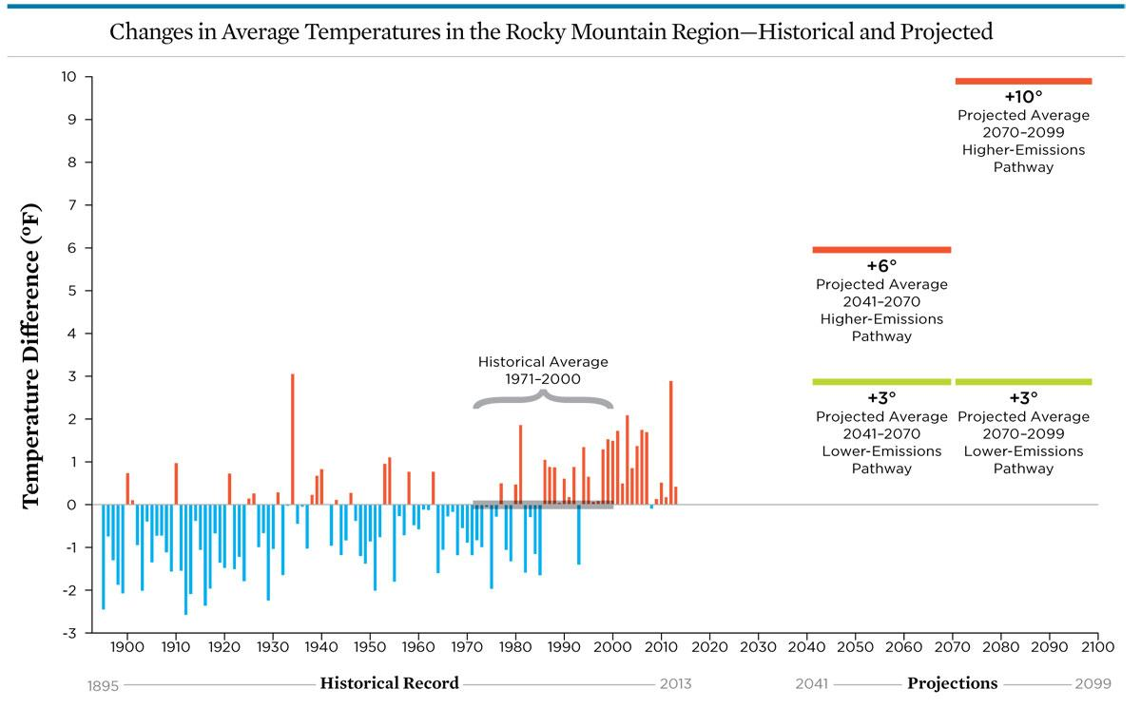
Historical and future climate change in the Rockies
5°C
2°C
Union of Concerned Scientists, based on Walsh et al. 2014
Notes:
an increase of 1.5°C = about 2.7°F of additional warming, an increase of 2°C = about 3.6°F

Slide 45
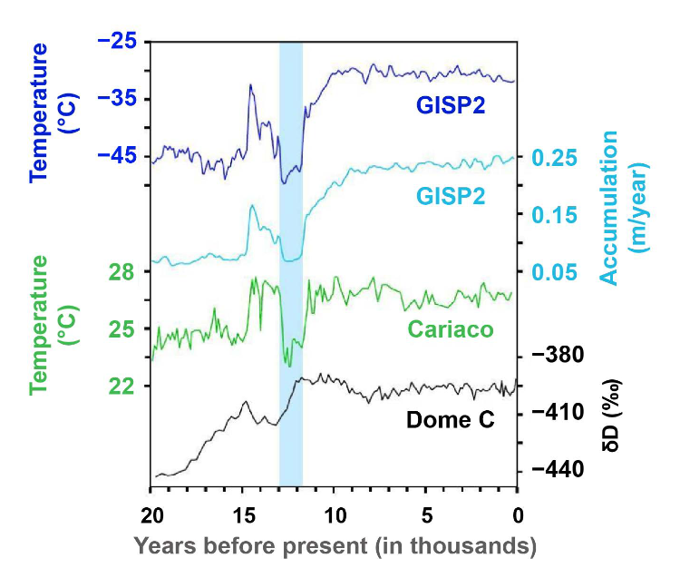
Each climate warming is unique
Previous warming ~20,000 yrs ago
Driven by orbital parameters
It took ~3,000 years for temperature to rise 2°C
Period of dramatic cooling
Extreme flooding events
Rapid warming events (10°C in a decade in Greenland)

Slide 46
Each climate warming is unique
Contemporary warming
Driven by GHGs, warming during an interglacial
It will take < 200 years for temperature to rise 2°C
Extreme drought events and wildfires
Moss et al. in review

Slide 47
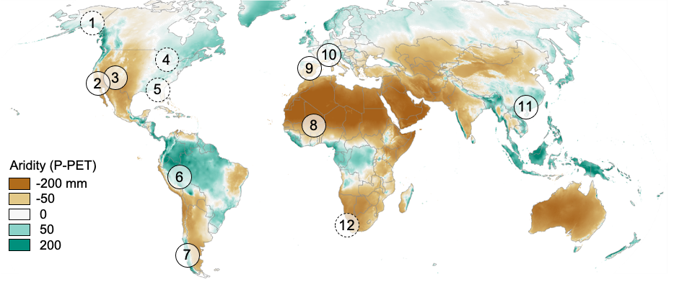
Contemporary drought-triggered transformations
Moss et al. in review
Notes:
FIGURE 2: Recent examples of in-progress (solid outlines) or emerging (dotted lines) transformational ecological droughts (TEDs) from across the globe, based on literature review. Mechanisms involved with each TED are included where evidence exists, although not all studies investigated the possibility of each mechanism, and therefore the absence of a particular mechanism may reflect lack of information. We emphasize that this not an exhaustive list, but reflects the diverse geographies and mechanisms by which TEDs are occurring, and illustrates that drought-induced ecological transformations are occurring across an aridity gradient. The aridity gradient was defined by the average monthly water balance, precipitation [P] - potential evapotranspiration [PET], over the reference period [1980 - 2010] using the TerraClimate dataset (Abatzoglou et al. 2018). More detailed descriptions of TED examples are found in Supplementary Information S1.

Slide 48
Implications for the Rockies
Rapid ecological change and transformation are likely in the coming decades across the Rockies
Landscape characteristics may play only a weak role, but southwesterly slopes may change faster
Any one ecosystem type may transform into multiple different types of new systems across space
Ecological trajectories may be challenging to anticipate

Slide 49
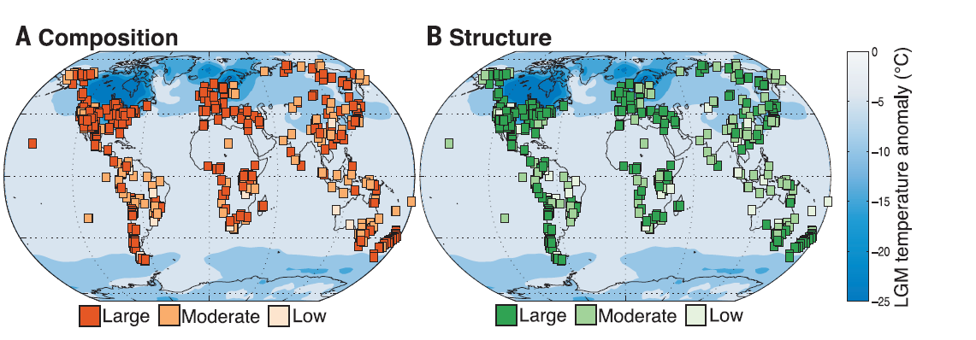
Paleo-transformations were pervasive
Nolan et al. 2018 Science

Slide 50
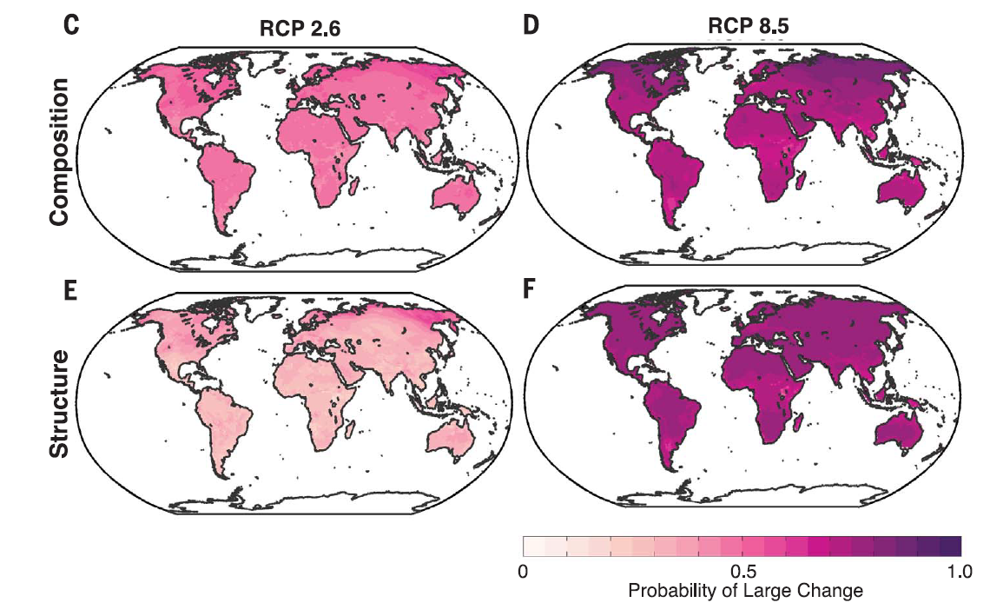
Threat of future transformations is everywhere
Nolan et al. 2018 Science

Slide 51
Implications for climate adaptation
Transformation is coming
Pick your favorite framework – RRT, RAD, AAA, RRRR – bring the likelihood of transformation into decision-making
Re-evaluate goals and objectives
Brainstorm proactive adaptation strategies | mechanistic
Anticipating trajectories | directing trajectories

Slide 52
Making decisions about transformation
Crausbay et al. 2022 BioScience

Slide 53
Thanks!
shelley.crausbay@usda.gov

