Slide 1
The increasing role of drought in ecological transformation
Wynne E. Moss^{1,2}, Shelley Crausbay^{3,2}, Imtiaz Rangwala^{4,5} and the TED working group
1. Conservation Science Partners, Inc.
2. Current address, Moss: U.S. Geological Survey Northern Rocky Mountain Science Center, Bozeman, MT
3. Current address, Crausbay: U.S. Forest Service Office of Sustainability and Climate
4. North Central Climate Adaptation Science Center
5. University of Colorado-Boulder
TED Working Group: Jay Wason, Clay Trauernicht, Camille Stevens-Rumann, Anna Sala, Caitlin Rottler, Gregory Pederson, Brian Miller, Dawn Magness, Jeremy Littell, Lee Frelich, Abby Frazier, Kimberly Davis,
Jonathan Coop, Jennifer Cartwright, & Robert Booth
This information is preliminary and is subject to revision. It is being provided to meet the need for timely best science. The information is provided on the condition that neither the U.S. Geological Survey nor the U.S. Government shall be held liable for any damages resulting from the authorized or unauthorized use of the information.

Slide 2
Project Support
USGS National Climate Adaptation Science Center
Image: Michael Wente, University of Colorado

Slide 3
Today’s talk
1. Ecological transformation and drought
2. Science synthesis
3. Mechanisms for transformational ecological drought

Slide 4
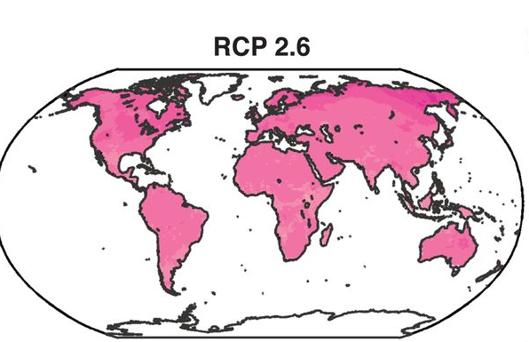
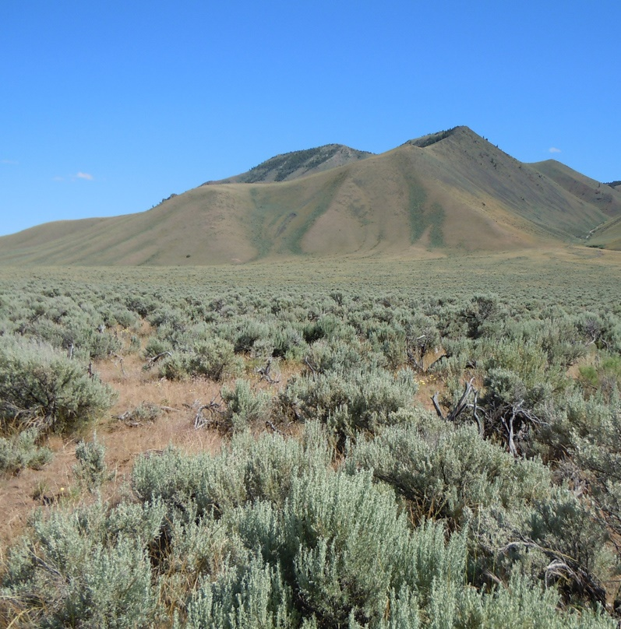
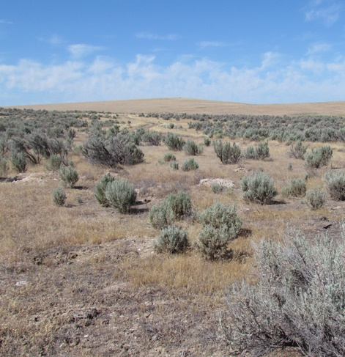
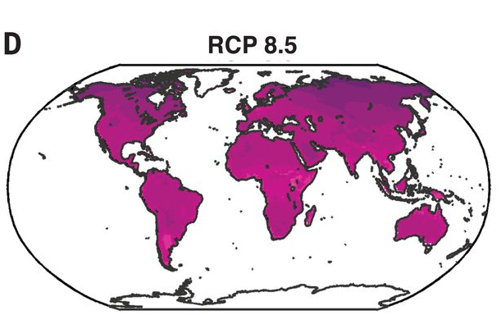
Ecological transformation: The dramatic and irreversible shift in multiple ecological characteristics of an ecosystem, the basis of which is a high degree of turnover in ecological communities (Crausbay et al. 2022, BioScience)
Probability of a large change in vegetation composition
Transformation of sagebrush steppe due to grass invasion
0
0.5
1.0
Nolan et al. 2018. Science
Images: www.nifc.gov

Slide 5
Ecological transformation in an era of extremes
Increasing climate extremes
Short term weather variability
Climate change
Resistance
Declining resistance and resilience
Ecological characteristic
Resilience
Adapted from Harris et al. 2018 Nature Climate Change

Slide 6
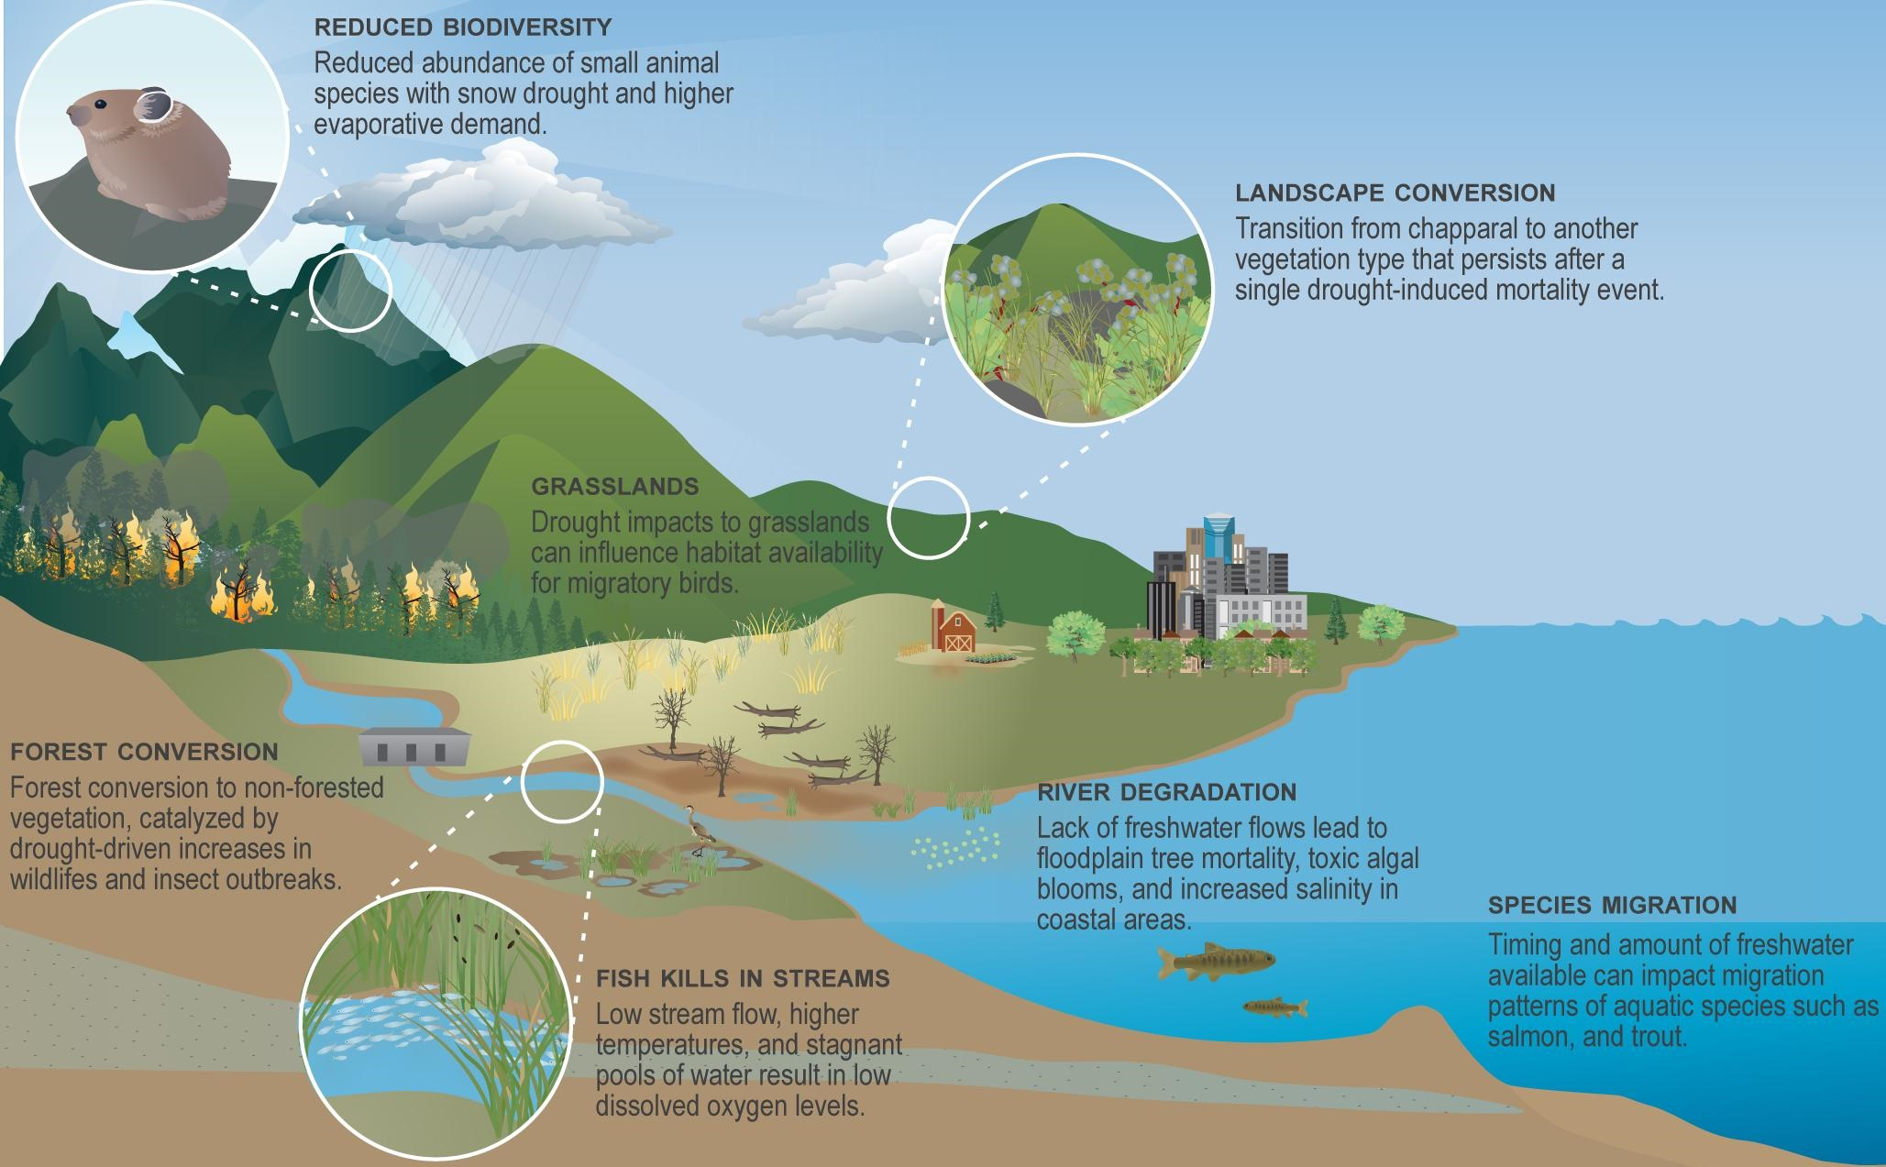
Drought and ecological transformation
Emerging themes in ecological drought that need immediate attention:
Novel drought conditions
Transformational drought impacts
Anticipatory drought management
Crausbay et al. 2020 One Earth

Slide 7
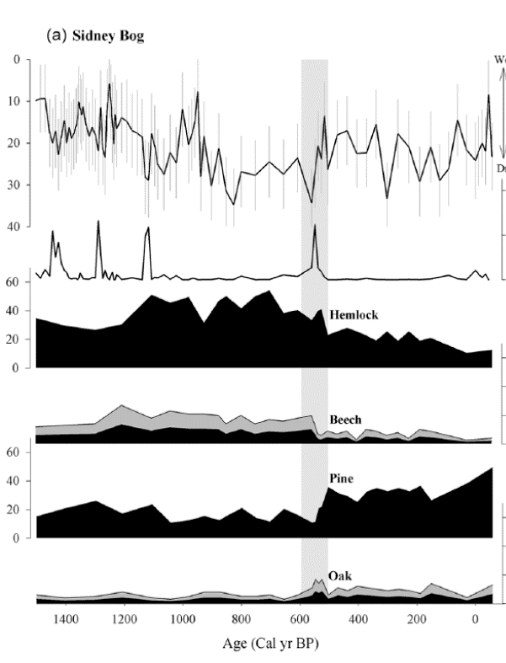
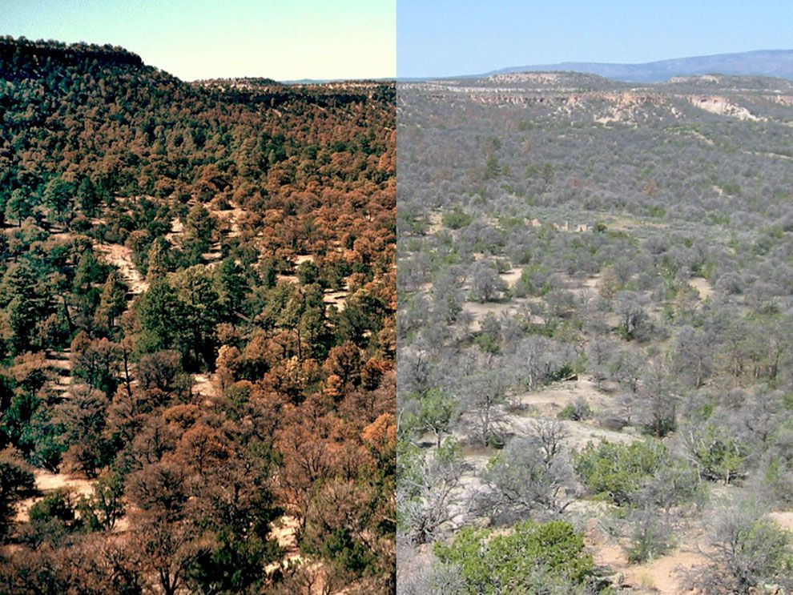
Transformational Ecological Drought (TED): an extreme and persistent change in ecological communities that is initiated or promoted by drought (Moss et al. in prep)
Drought (water table depth)
Fire (charcoal)
Compositional changes (pollen)
Breshears et al. 2008 Frontiers Ecol. Envir.
Clifford and Booth. 2015 The Holocene

Slide 8
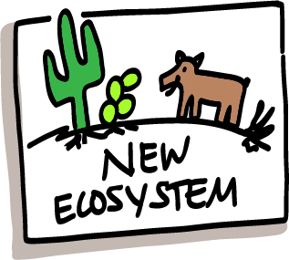
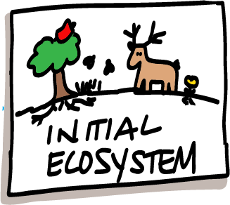
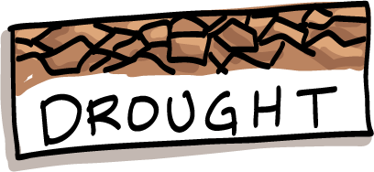
Tackling a complex problem
climatology
disturbance
ecology
physiology
hydrology
paleoecology
community ecology
Images: Angie Moline

Slide 9
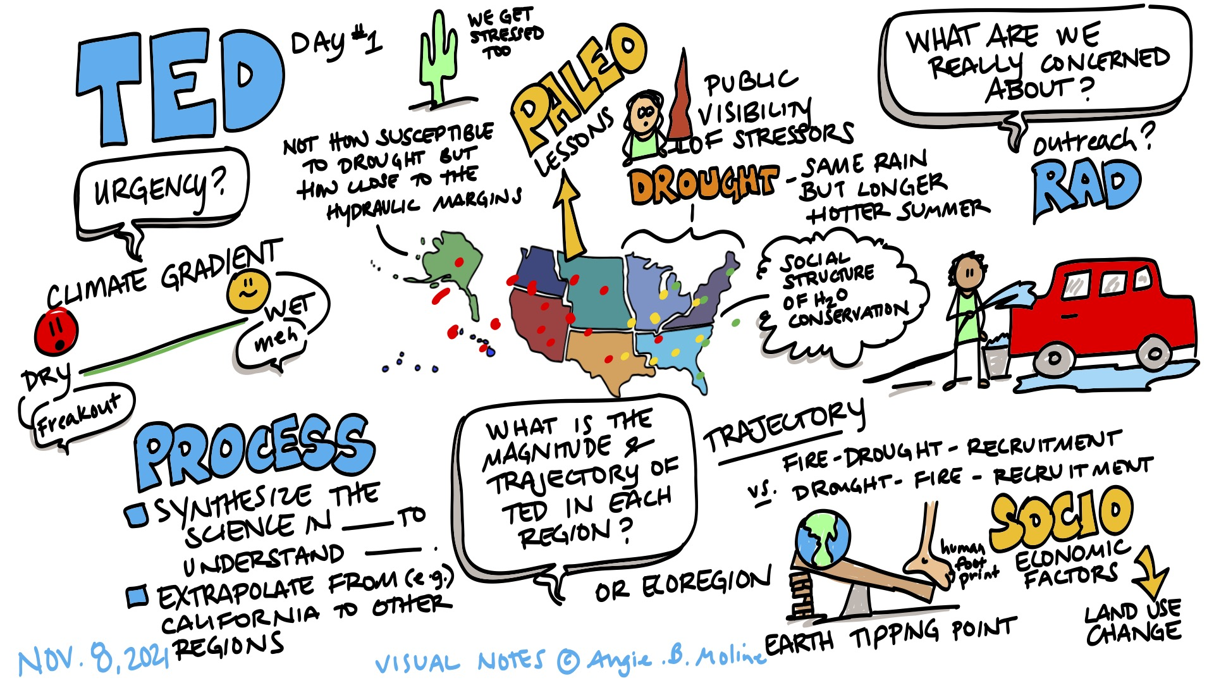
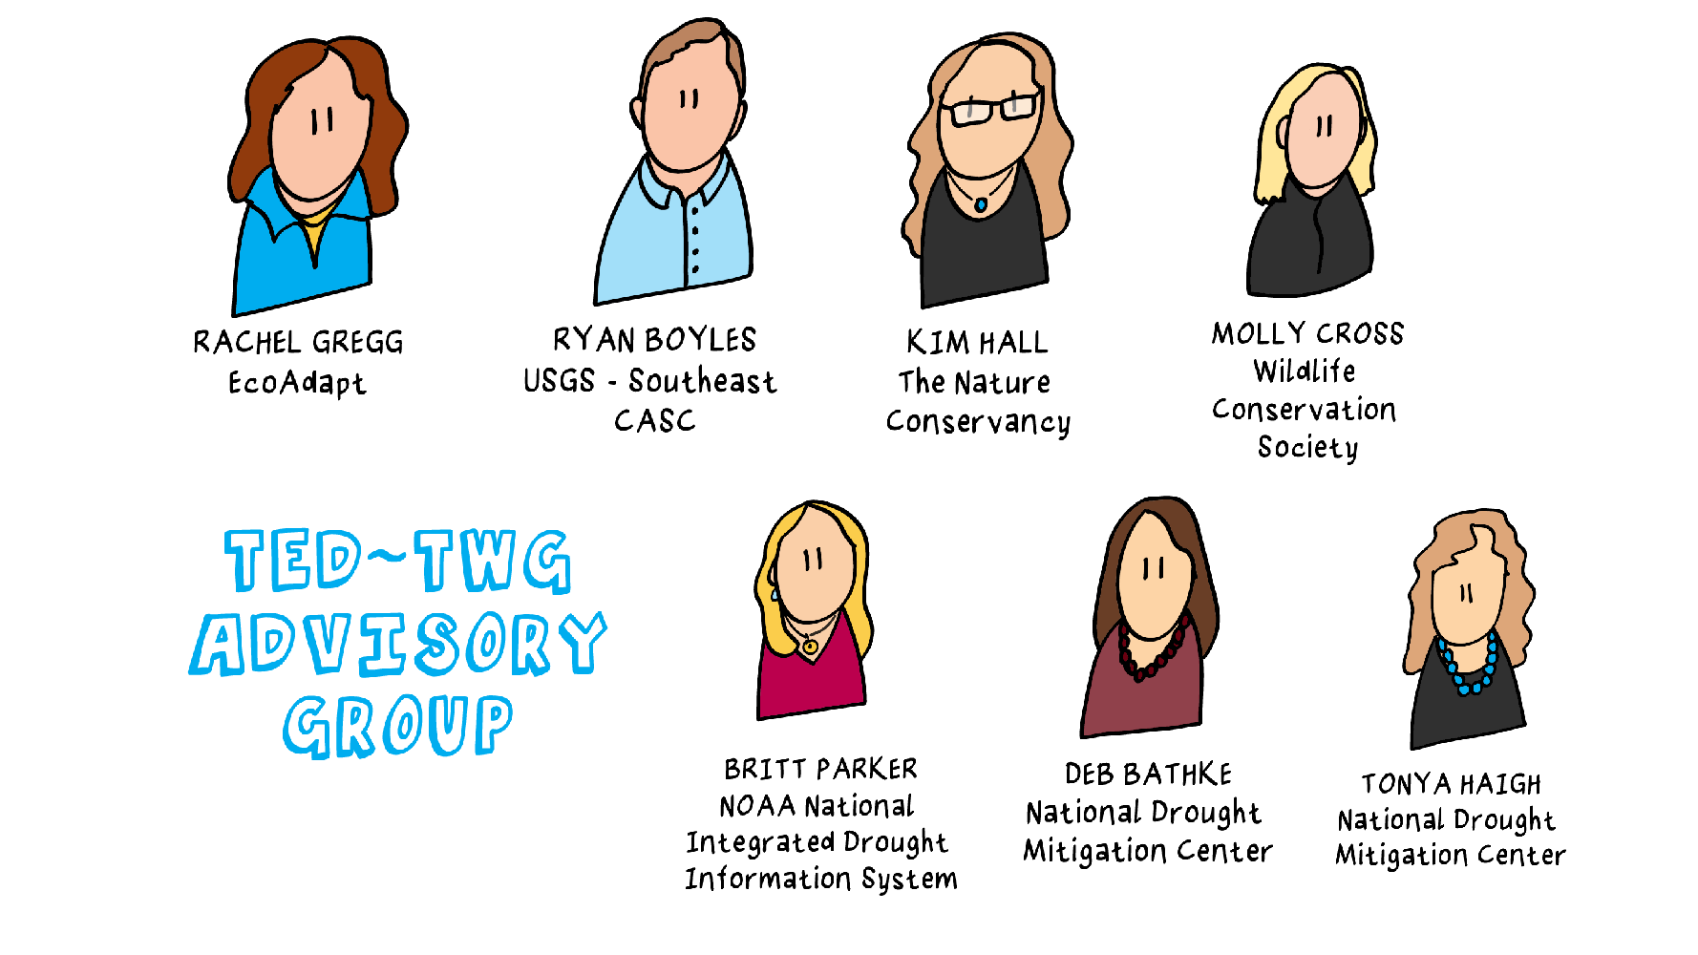
Interdisciplinary team science
The TED working group
The TED advisory group
Images: Angie Moline
Stacy Lischka
Angie Moline

Slide 10
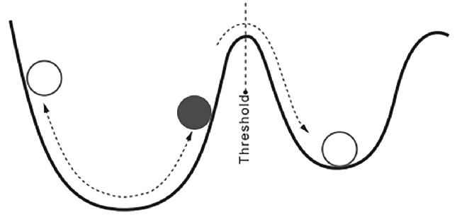
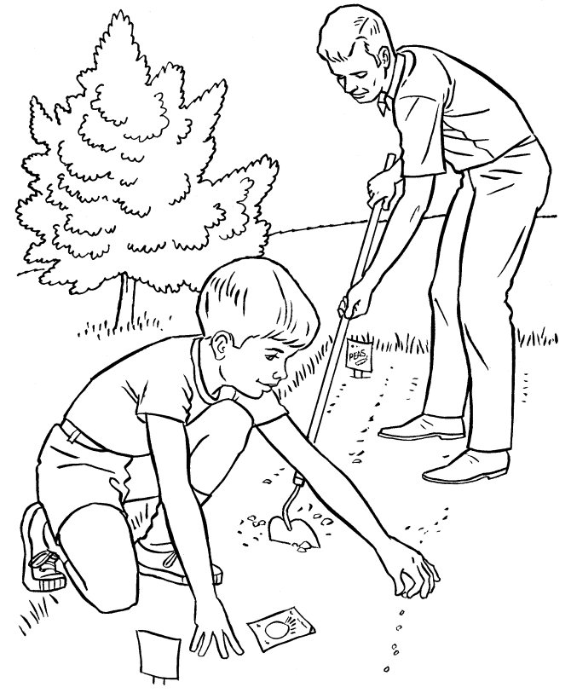
Synthesizing the science on TED
(1) Where are TEDs emerging, and do they tend to follow similar pathways?
(2) How do TEDs happen and what does that tell us about management strategies?
(3) Why is the risk of TED increasing?
From scientific theory…
…to adaptation action
Images: Keane et al. 2018 Ecosphere, www.ColorLuna.com

Slide 11
Today’s talk
1. Ecological transformation and drought
2. Science synthesis
3. Mechanisms for transformational ecological drought

Slide 12
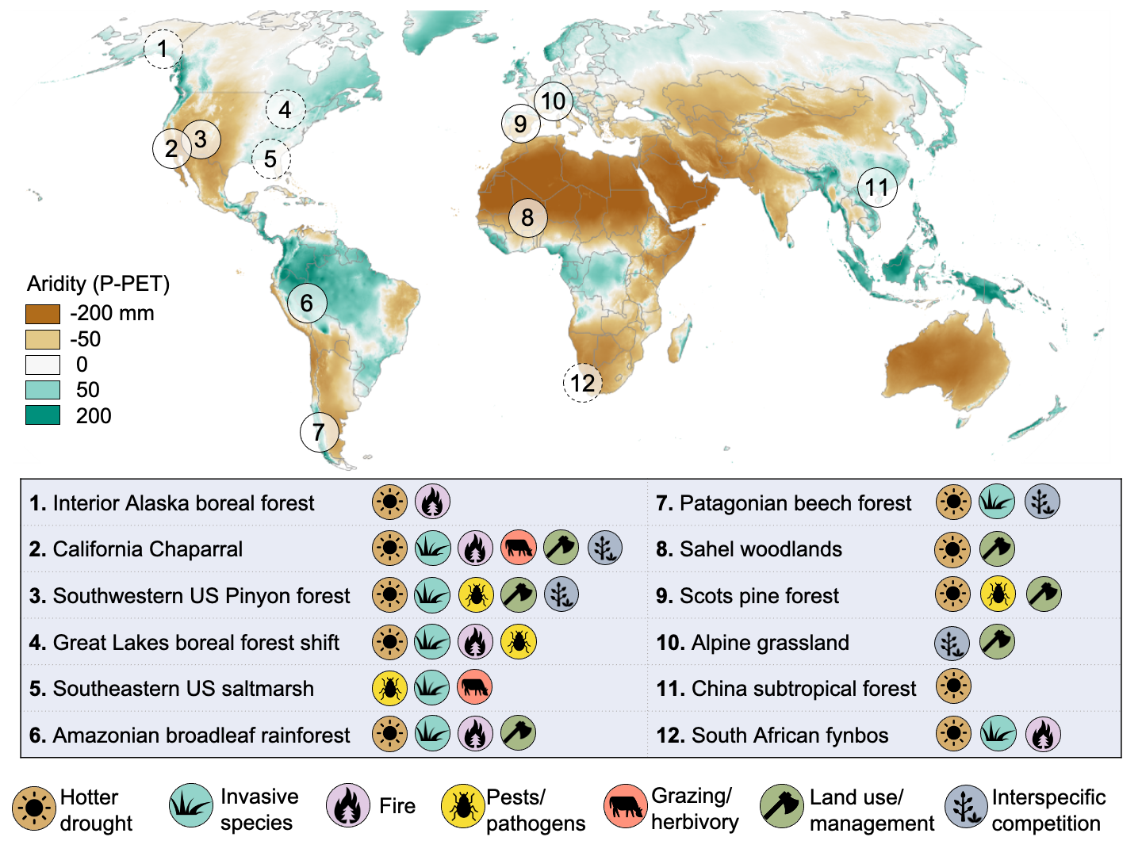
TEDs are happening across the globe
Moss et al. in prep
Preliminary Information-Subject to Revision. Not for Citation or Distribution.

Slide 13
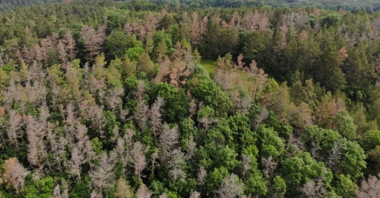
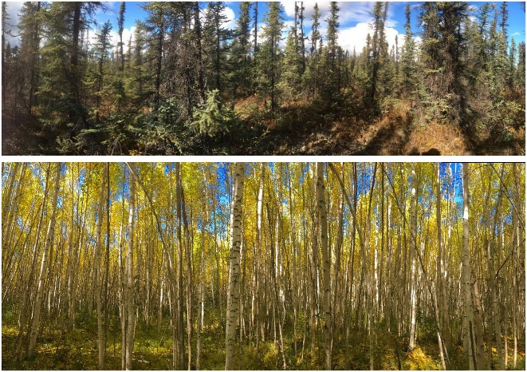
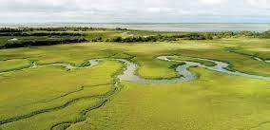
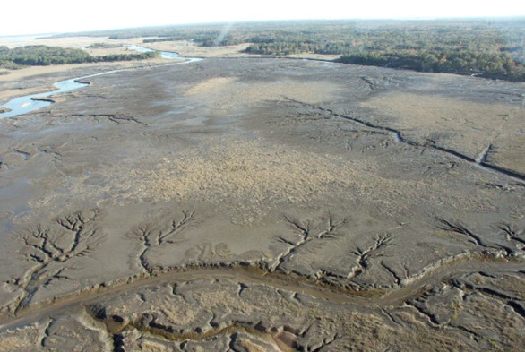
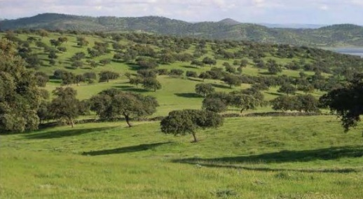
TEDs are happening across the globe
Moss et al. in prep
Preliminary Information-Subject to Revision. Not for Citation or Distribution.
Baltzer et al 2021 PNAS;
Johnstone et al 2020 Ecosphere
Replacement of pine forest by oak woodlands
Transformation of black spruce forest
Loss of salt marsh vegetation
Image: Henrik Hartmann
Image: John Schalles
Image: Gabriel Blanca
Image: Roger Ruess
Image: Georgia DNR
Vila-Cabrera et al 2013 Ecosystems
Gazol et al 2018 Front Plant Sci
Alber et al 2008 Estuar Coast Mar Sci;
McKee et al 2004 Global Ecol Biogeogr

Slide 14
Land use and management
Drought
Ecologically available water
Human water use
Landscape features
Moss et al. in prep
Preliminary Information-Subject to Revision. Not for Citation or Distribution.

Slide 15
Compounding disturbances
Novel climate context
Land use and management
Recovery
Recruitment
Drought
Ecologically available water
Linked disturbances/ biotic interactions
Compositional shifts
Novel climate context
Human water use
Mortality
Transformation
Landscape features
Compounding disturbances
Preliminary Information-Subject to Revision. Not for Citation or Distribution.

Slide 16
Compounding disturbances
Novel climate context
Land use and management
Recovery
Recruitment
Drought
Ecologically available water
Linked disturbances/ biotic interactions
Compositional shifts
Novel climate context
Human water use
Mortality
Transformation
Landscape features
Compounding disturbances
Preliminary Information-Subject to Revision. Not for Citation or Distribution.

Slide 17
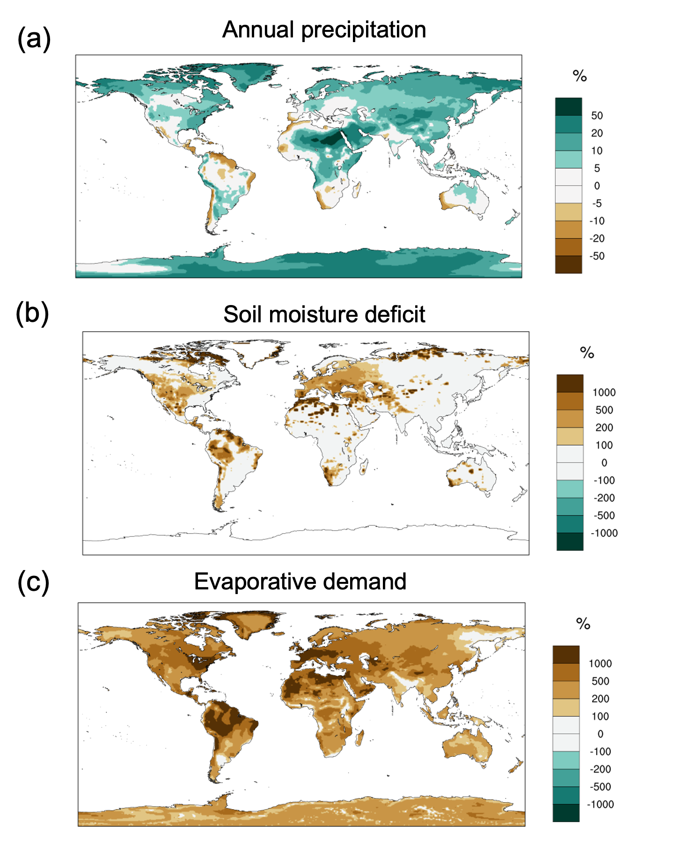
Shifting drought regimes
Change in frequency of drought events (where monthly values exceed the 99th percentile of historical period)
Moss et al. in prep.
Preliminary Information-Subject to Revision. Not for Citation or Distribution.
Notes:
Figure 1. Changes in future precipitation and drought regimes. (a) Projected changes in annual precipitation by mid-21st century (2036 - 2065), indicating increased precipitation across much of the globe. (b) Projected changes in the frequency of extreme atmospheric drought events by mid-21st century, which are defined as monthly potential evapotranspiration values (PET) exceeding the 99th percentile threshold during a historical (1971-2000) period. (c) Projected changes in the frequency of extreme soil moisture drought events by mid-21st century, defined as monthly soil moisture deficits exceeding historical 99th percentile thresholds. All projection estimates are obtained from 40 simulations of the Community Earth System Model version 1 Large Ensemble project (CESM1 LENS; Kay et al., 2015).

Slide 18
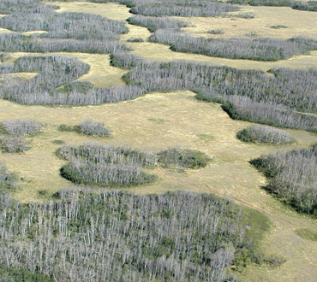
A future with hotter, deadlier droughts
A “triple threat” for plant mortality
Aspen die-offs are linked to periods with extremely high evaporative demand
Atmospheric drought
Soil moisture drought
Heat stress
Hammond et al. 2022, Nat Comm
Anderegg et al. 2013 Glob Change Biol
Image: Michaelian et al. 2011 Glob Change Biol

Slide 19
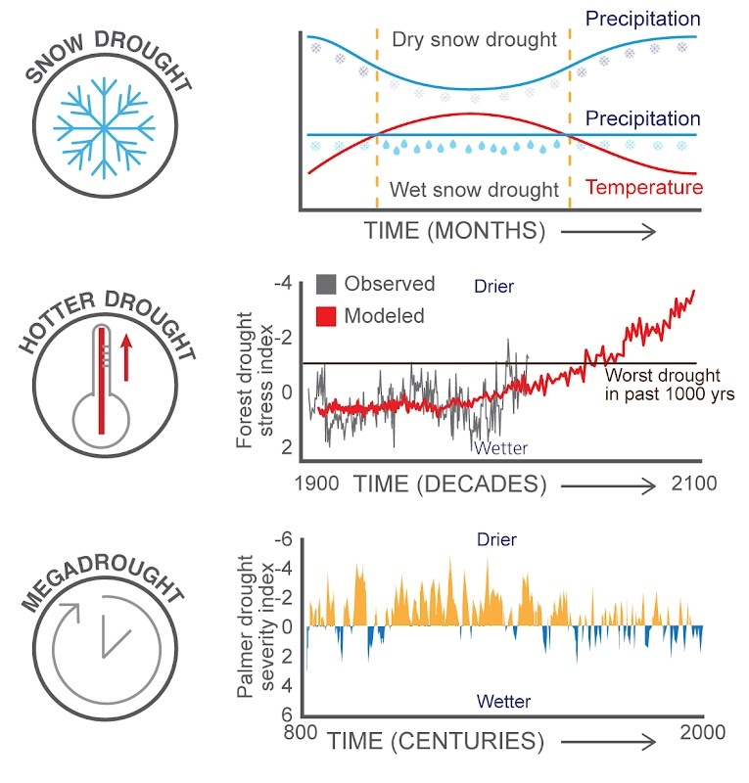
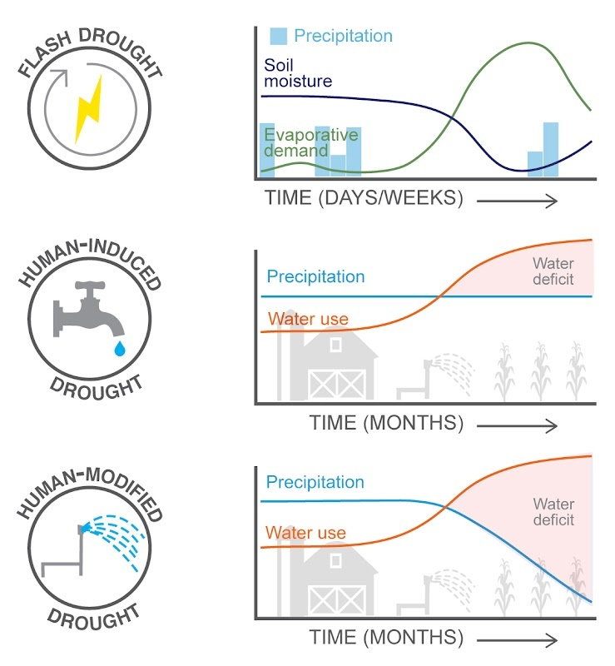
A future with novel drought regimes
Crausbay et al. 2020 One Earth

Slide 20
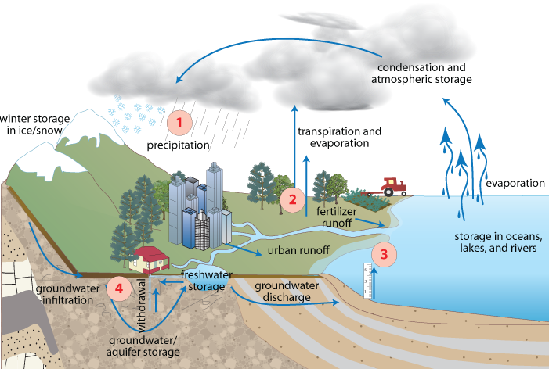
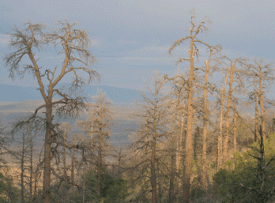
Ecologically Available Water: the quantity, timing, and quality of water available to ecosystems, considering all incoming and outgoing processes…
(Cravens et al. in review)
Drought
Ecologically available water
Ecological response
Image: Kate Boicourt, Integration and Application Network
Image: Craig Allen

Slide 21
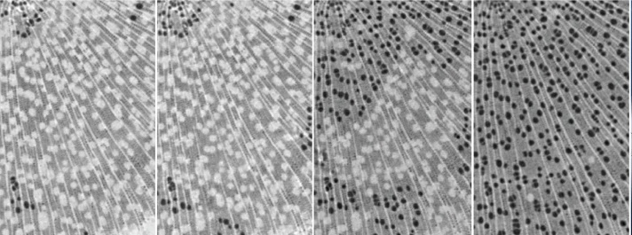
The link between drought and mortality
Drought
Spread of embolisms in plant tissue with increasing drought stress
Ecologically available water
Mortality
Image: Choat et al. 2018 Nature
Image: Craig Allen

Slide 22
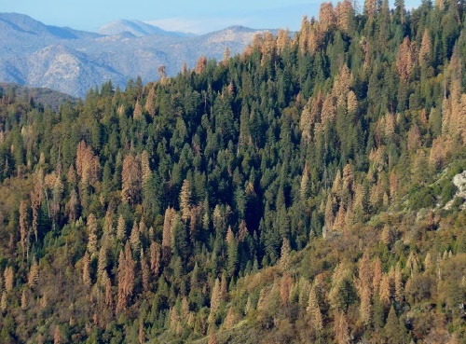
The link between drought and mortality
Drought mortality is shaped by forest management
Drought
Land use and management
Human water use
Ecologically available water
Landscape features
Mortality
e.g., Bradford et al. 2021 J Appl Ecol,
van Mantgem et al. 2020 Front For Glob Change, D’Amato et al. 2013 Eco App
Image: N. Stephenson

Slide 23
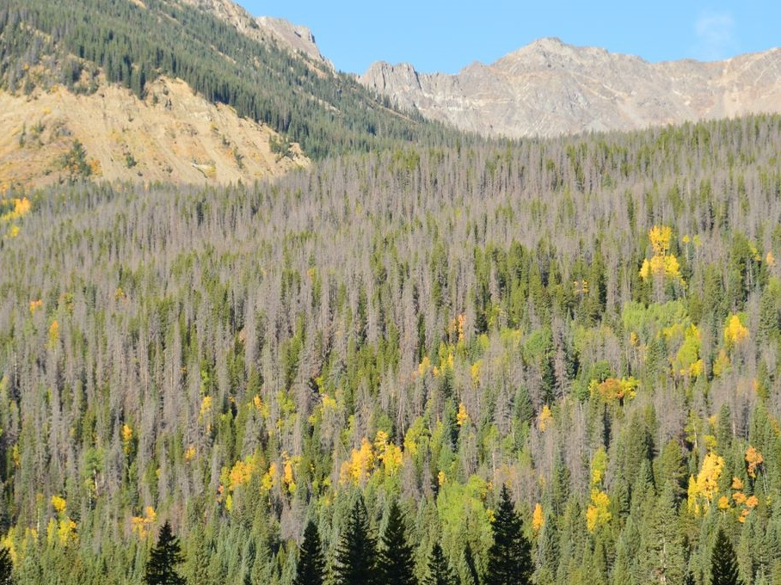
The link between drought and mortality
Lodgepole pine mortality from drought and mountain pine beetle attack in RMNP
Drought
Land use and management
Human water use
Ecologically available water
Landscape features
Mortality
Image: Michael Wente (University of Colorado)
Biotic interactions
Other disturbances

Slide 24
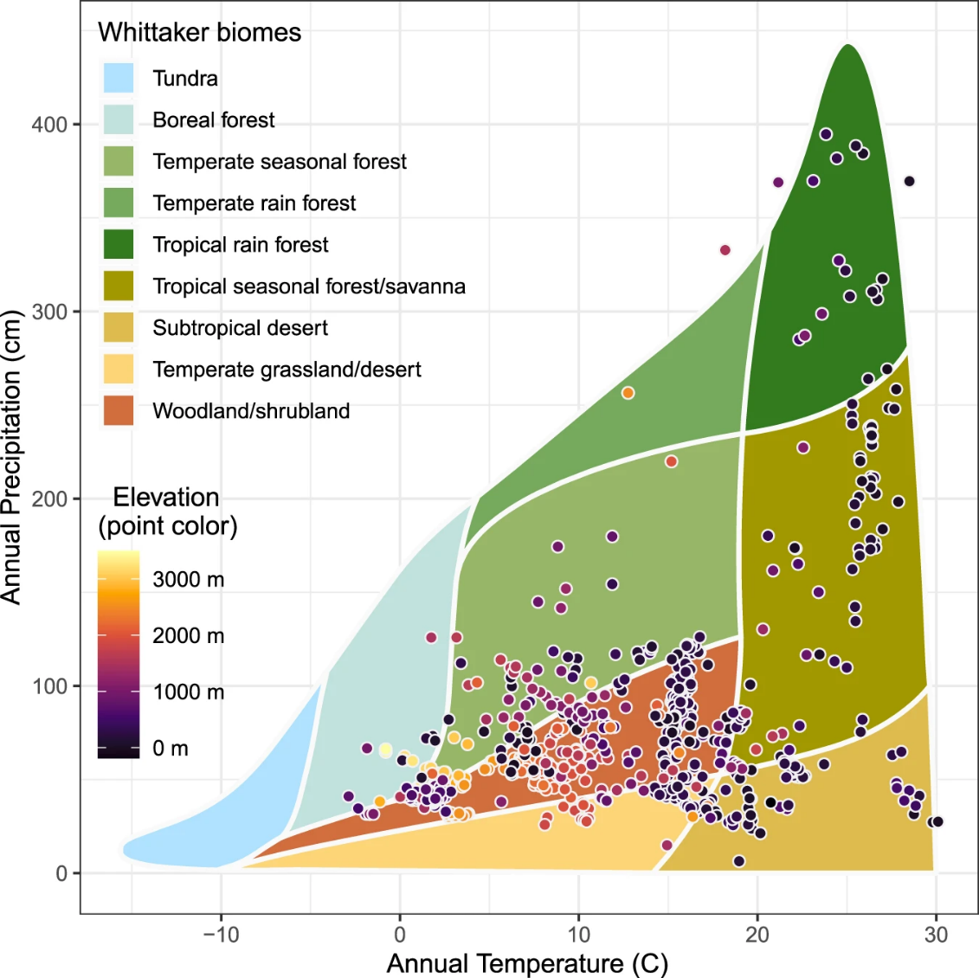
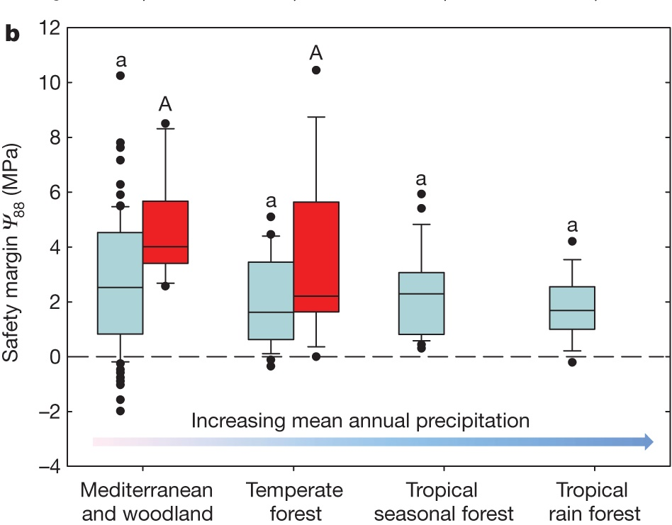
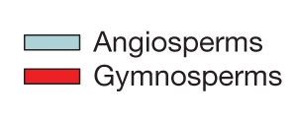
Drought-induced mortality
Mass tree mortality events have occurred across biomes
Many species, regardless of location, are living close to their hydraulic limit
Safety margin: the difference between water availability in natural conditions and the water availability that would cause hydraulic failure
Choat et al. 2012 Nature
Hammond et al. 2022 Nat Comm

Slide 25
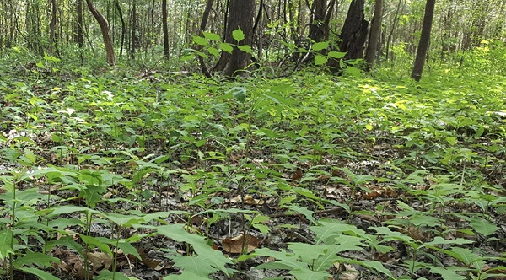
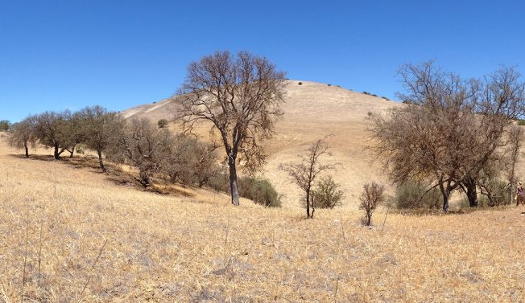
Population dynamics
Recruitment
Drought
Ecologically available water
Image: Pierce Young
Recovery
Mortality
Image: Todd Dawson

Slide 26
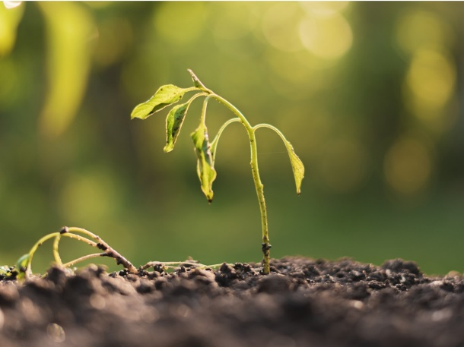
Population dynamics
Recruitment
Drought
Ecologically available water
Compositional Shifts
Transformation
Mortality
Image: Михаил Руденко

Slide 27
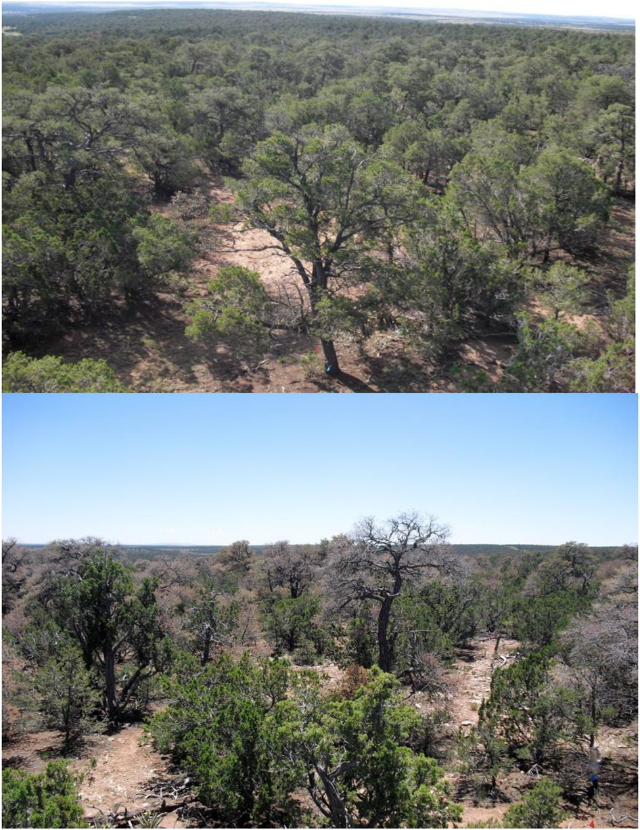
Limits to post-drought recovery
Micro-climate conditions
Drought-induced mortality in pinyon pine reduces canopy cover
Morillas et al. 2017 JGR Biogeo

Slide 28
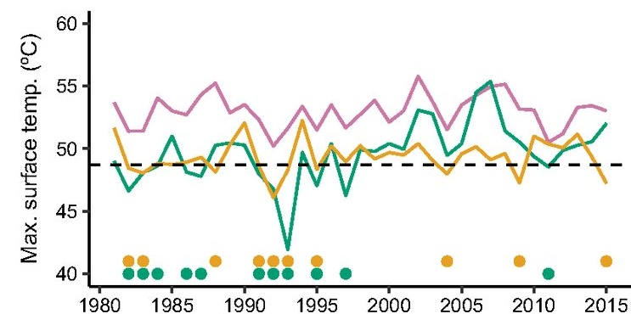
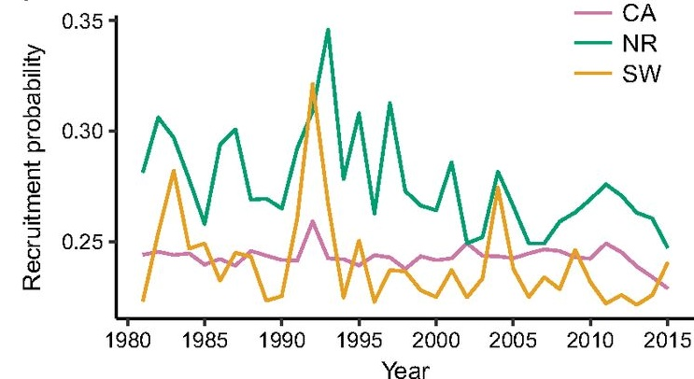
Limits to post-drought recovery
Recruitment of lodgepole pine (and other conifers) is increasingly limited by climate
Micro-climate conditions
Novel climate
Davis et al. 2019 PNAS

Slide 29
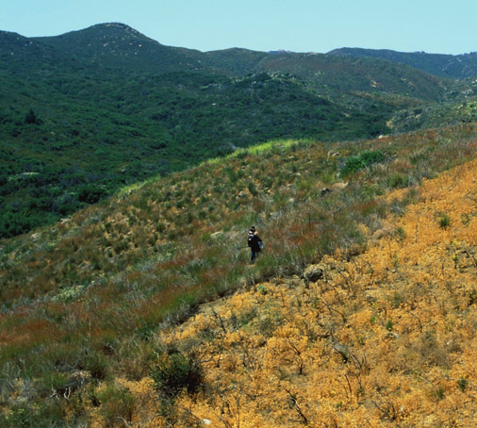
Limits to post-drought recovery
Establishment of non-native grasses suppresses chaparral recovery after drought
Micro-climate conditions
Novel climate
Biotic interactions
Image: R.W. Halsey
Jacobsen and Pratt 2018 New Phytol
Park and Jenerette 2019 Landscape Ecol

Slide 30
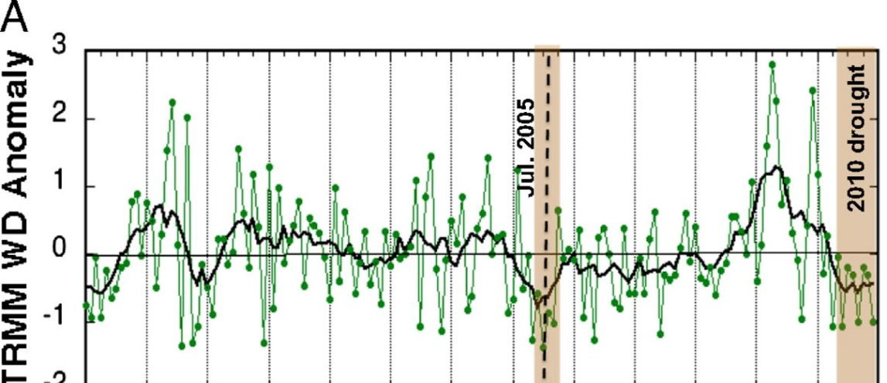
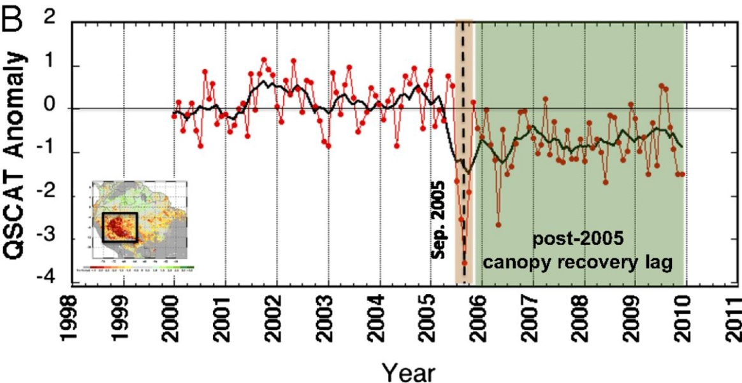
Limits to post-drought recovery
Drought index
Micro-climate conditions
Novel climate
Forest canopy health
Biotic interactions
Additional disturbances
Image: Saatchi et al. 2012 PNAS
Schwalm et al. 2017 Nature
Amazon forests cannot fully recover before the next drought occurs

Slide 31
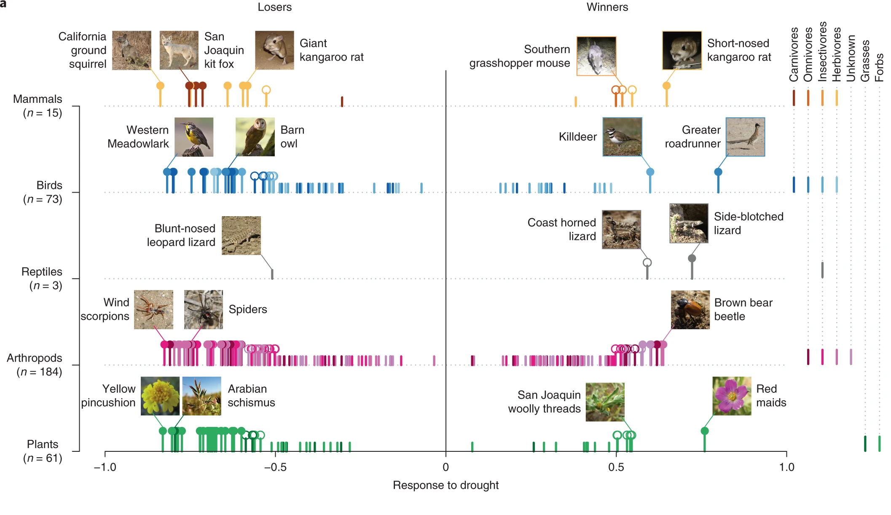
Change in relative abundance of species
Losers
Winners
Prugh et al. 2018 Nature Climate Change

Slide 32
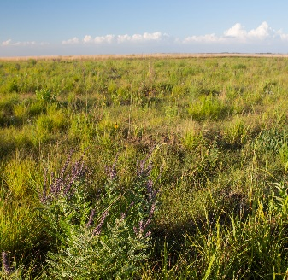
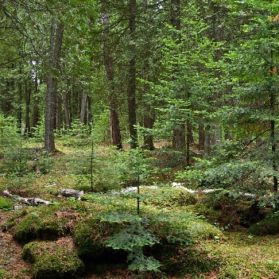
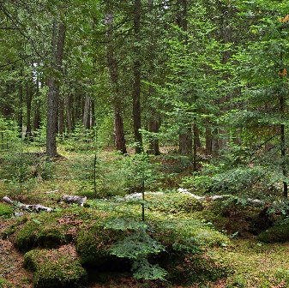
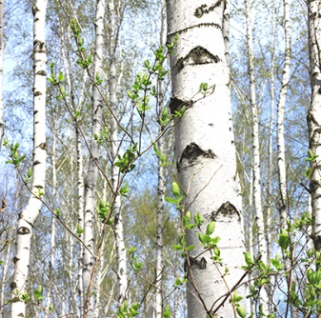
Ecological trajectories
Drought
Previous condition
Future state
Image: adapted from Magness et al. 2022 BioScience
Time
Frelich et al. 2021 Forests.

Slide 33
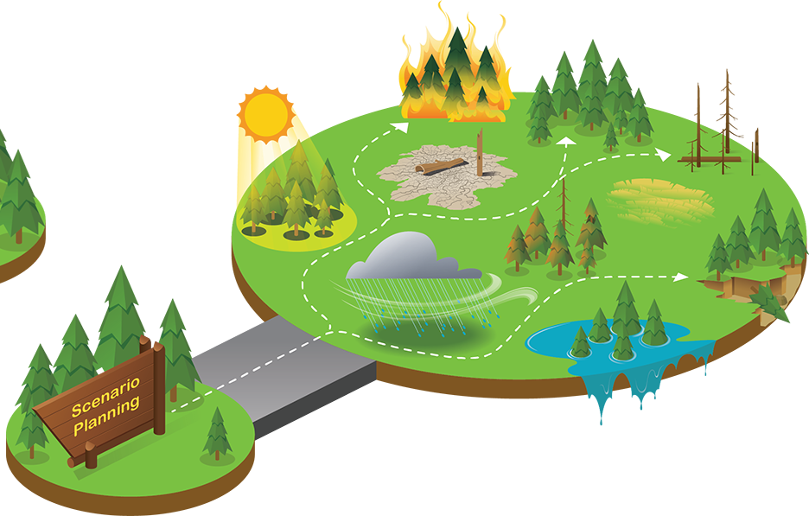
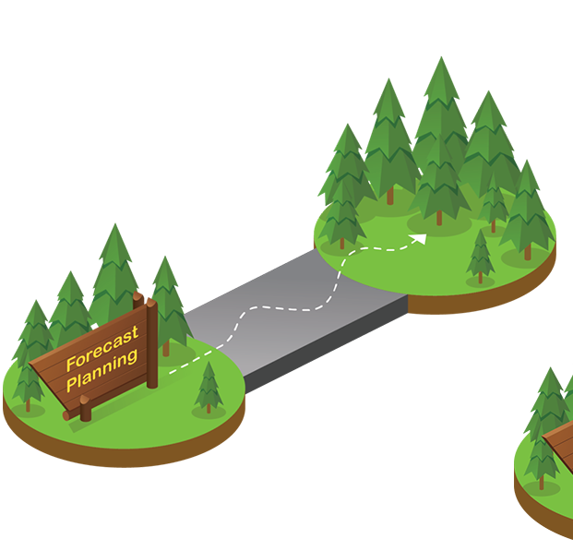
Ecological trajectories and scenario planning
Drought event
Future state?
Future states?
Current state
Current state
Drought event
Image: National Park Service

Slide 34
Drought adaptation strategies are diverse
Compounding disturbances
Novel climate context
Recruitment
Land use and management
Linked disturbances/ biotic interactions
Recovery
Drought
Ecologically available water
Compositional shifts
Human water use
Mortality
Transformation
Landscape features
Compounding disturbances
Preliminary Information-Subject to Revision. Not for Citation or Distribution.

Slide 35
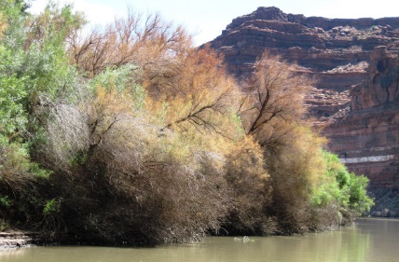
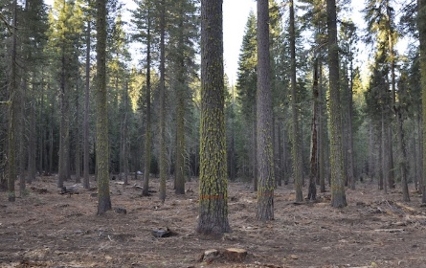
Drought adaptation strategies are diverse
Gregg and Kershner 2019: Extremes to Ex-Streams: Ecological Drought Adaptation in a Changing Climate
Control invasive species
that use more water than native species
(e.g., Cavaleri and Sack 2010 Ecology)
Forest thinning
to reduce competition, fire, or pest/pathogen attack
(e.g., Bradford et al. 2021 J Appl Ecol)
Beaver dams (or analogs)
to enhance water storage
(e.g., Pearce et al. 2021 Hydrological Processes)
Monitoring and early warning
to anticipate and respond to ecological impacts
(e.g. Jiao et al. 2021 Remote Sensing Env)
Native grazing
to increase biodiversity and ecosystem resilience
(e.g., Ratajczak et al. 2022 PNAS)
Maintain/restore soil health
to improve water storage and plant productivity
(e.g., Jia et al. 2020 J Ecol)
Images (clockwise from top): the Tamarisk Coalition, UC Merced, Emily Fairfax, Getty Images, NDMC, Matthew Brown (AP)

Slide 36
Drought adaptation strategies are diverse
Image: Bill Henry
Image: Ashley J. Peters
Image: USGS; Refs: Thompson et al. 2021. Fisheries; Schuurman et al. 2022. BioScience.

Slide 37
Thank you
Co-authors: Shelley Crausbay, Imtiaz Rangwala, Jay Wason, Clay Trauernicht, Camille Stevens-Rumann, Anna Sala, Caitlin Rottler, Gregory Pederson, Brian Miller, Dawn Magness, Jeremy Littell, Lee Frelich, Abby Frazier, Kimberly Davis, Jonathan Coop, Jennifer Cartwright, & Robert Booth
Contact: wmoss@usgs.gov
Image: Chris Helzer (TNC)

