Slide 1
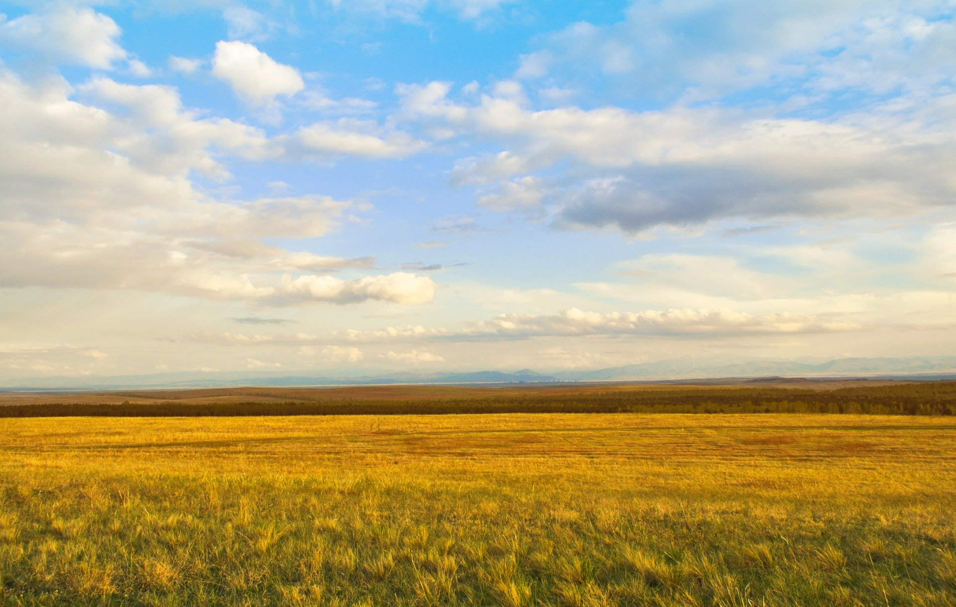
"Climate-smart" management in the North Central grasslands: Manager perspectives on challenges, capacity-building, and research integration
Elizabeth Woolner, Heather Yocum, Christy Miller-Hesed
8/11/23

Slide 2
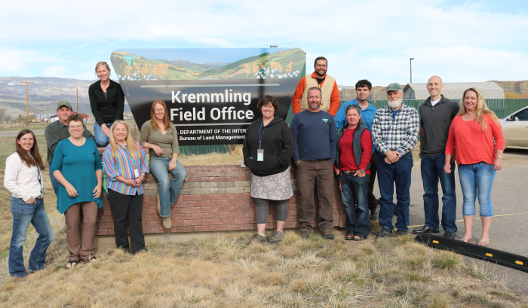
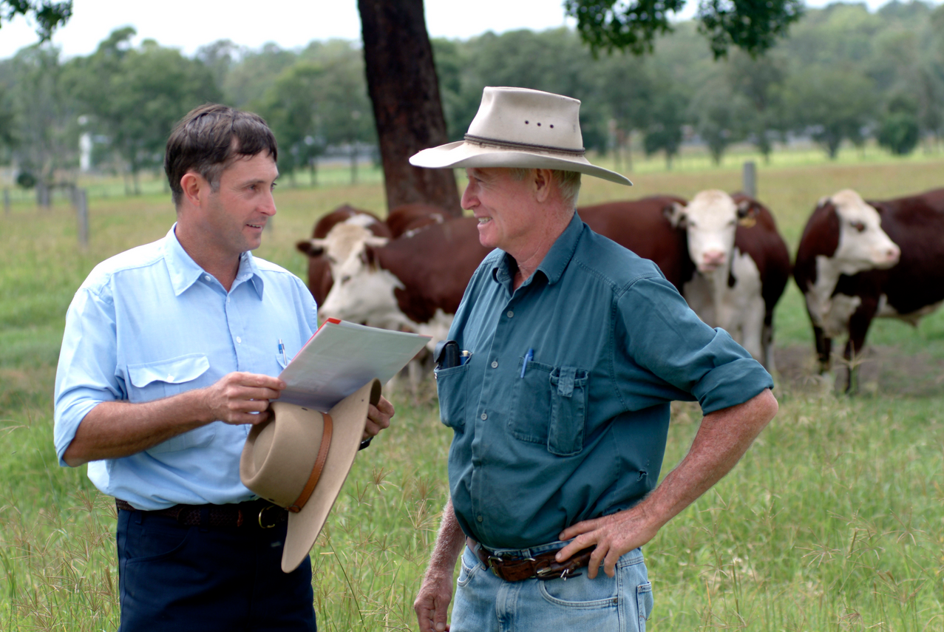
Project introduction
Goal: Support the grasslands synthesis project by discussing findings with grasslands managers while building relationships with individuals and agencies
Target agencies:
  BLM
  FWS
  Nebraska Game & Parks
    Other NE agencies
  Wyoming Game & Fish
Questions: Their duties/responsibilities; main ecosystem threats; collaboration and novel ways of thinking; climate and weather info needs

Slide 3

Qualitative Research Methods
  IRB & other permissions
  Recruitment
  Interviews (17 total)
  Thematic Analysis
    Field notes / memos
    Preliminary Coding
    Codebook development
    "Final" coding
  Verification

Slide 4
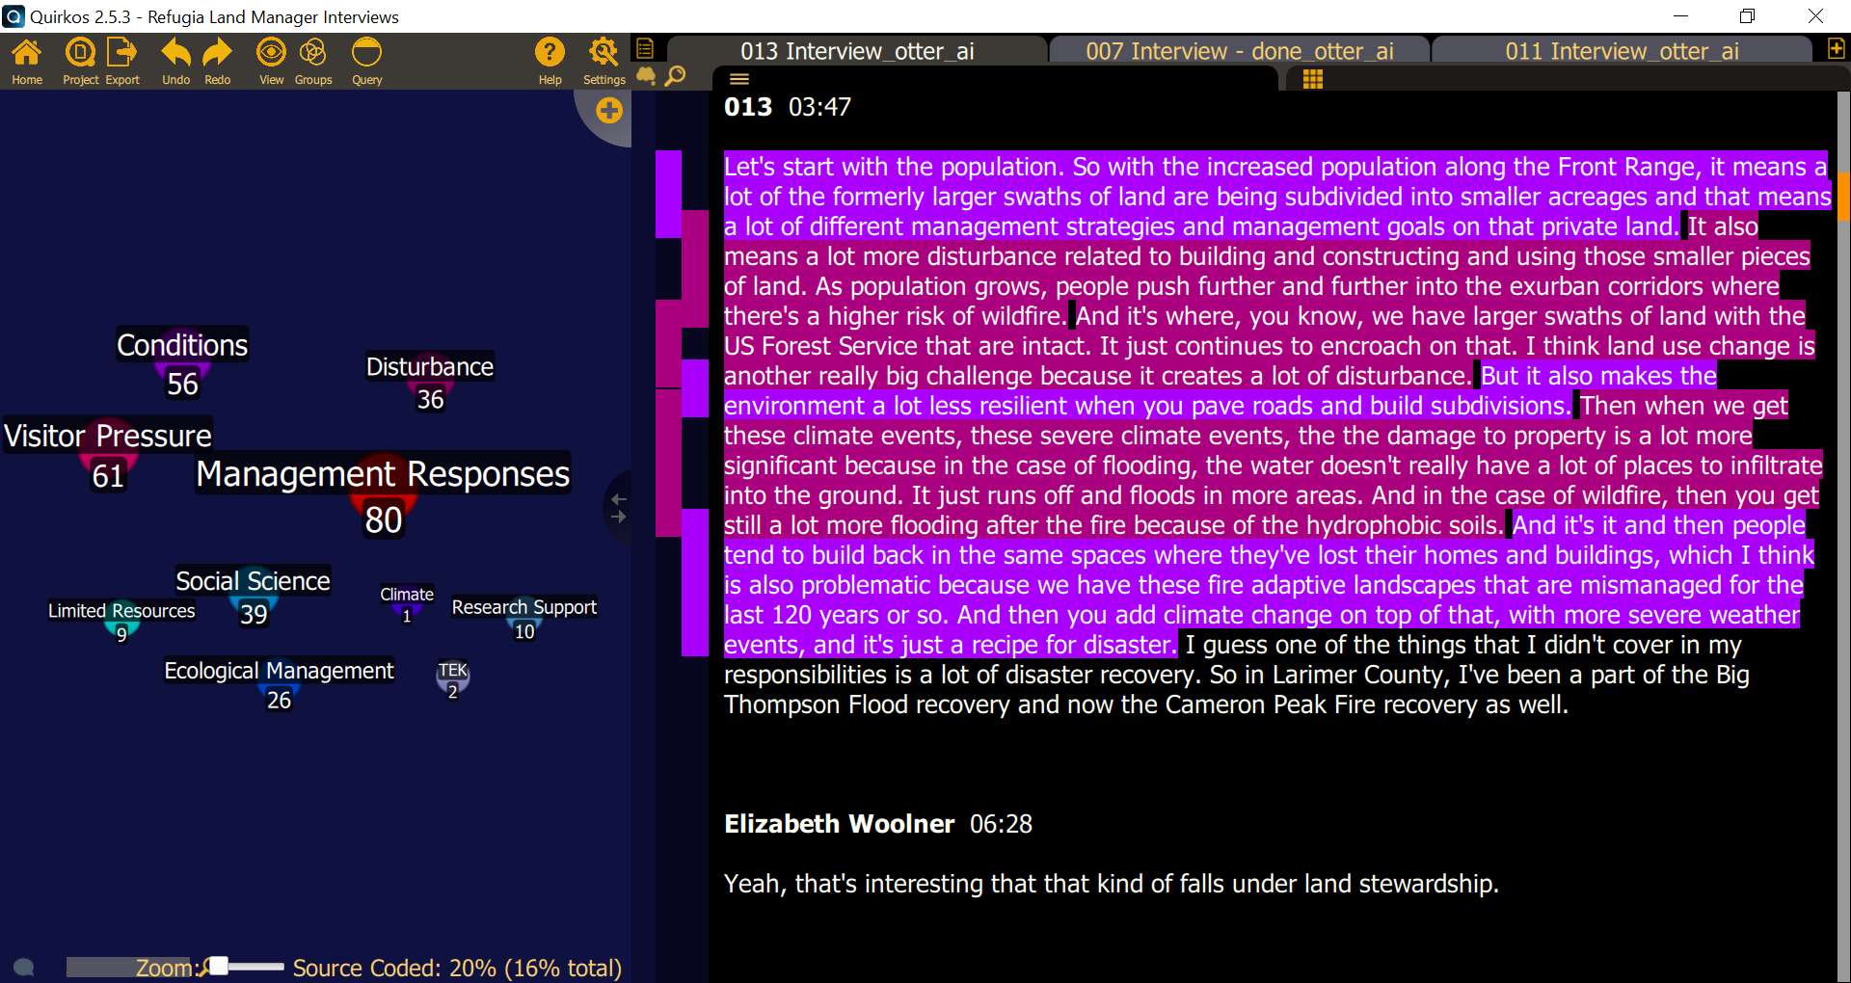

Slide 5
Preliminary Findings

Slide 6
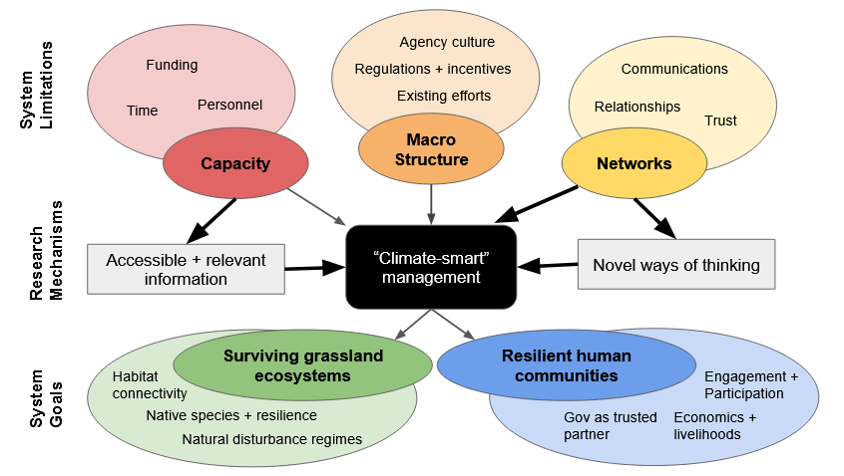

Slide 7
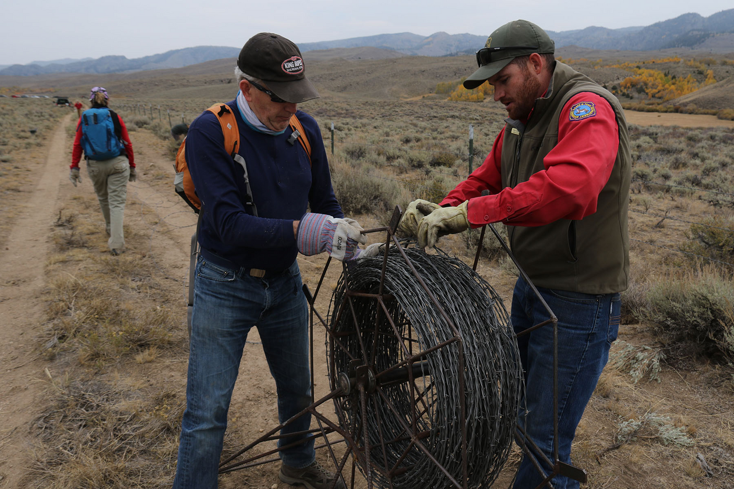

I mean it's our personal bias. It's our fear of the unknown ... A [lack of] willingness to listen or to consider different viewpoints is a barrier. And you break those down by starting relationships. Build trust and then you get your answers. You don't get it the other way.

Slide 8
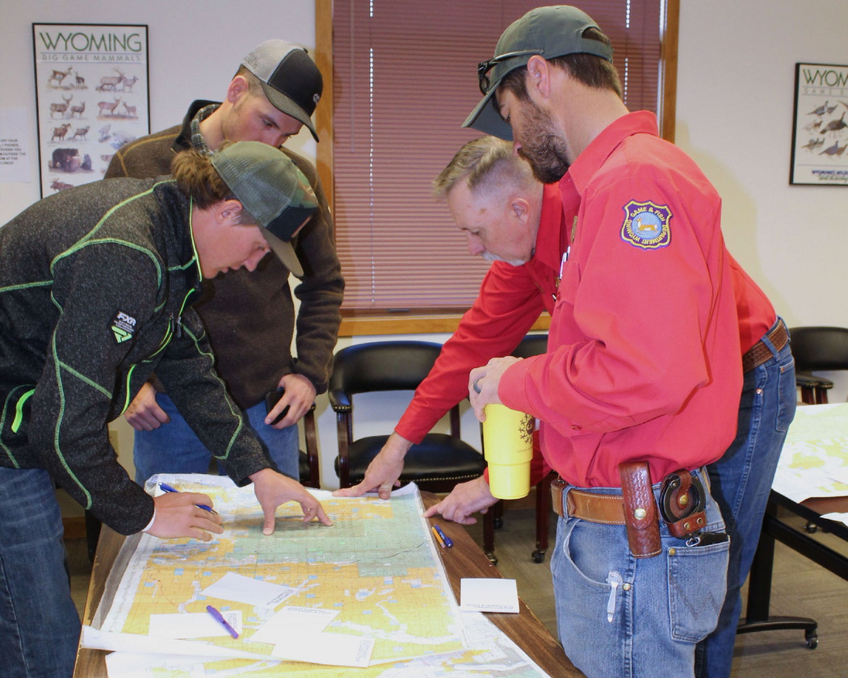
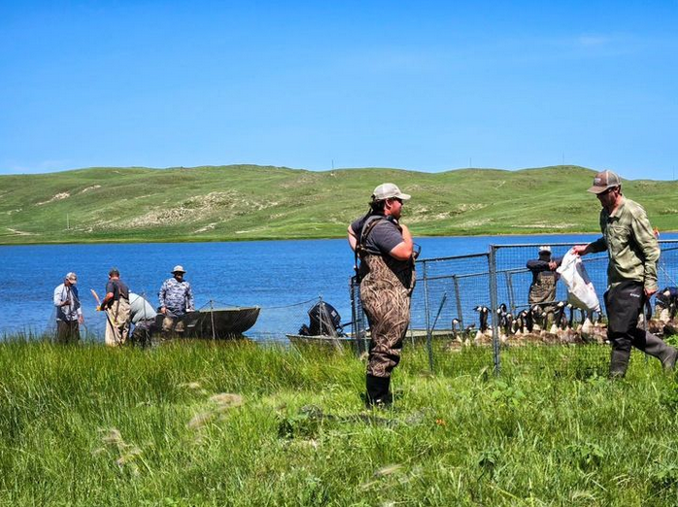
Why qualitative research?
Rich data collection
Emotion & Tone
  Climate exhaustion, grief, uncertainty, inadequacy
  Belief, dedication
"Making member's meanings" & setting the stage for future research
Relationship and trust building

